Slide 1
Error Correction in Quantum Communication Networks
September 8, 2017
Martin Suchara
AT&T Labs Research
INQNET

Slide 2
What to do with Transmission Errors in Quantum Networks?
- Our goal: more reliable quantum communication over a greater distance
- In this talk:
      Introduction of quantum error correction
      Numerical simulations of the surface code
      Broader question: utilizing error correction in communication networks
quantum channel
qubit decoherence and loss

Slide 3
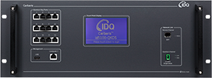
Quantum Communication Network of the Future
- Transmission: single logical qubit encoded into multiple physical qubits sent via a noisy channel
- Encoder and decoder: simple quantum circuits encode logical qubits; also need multi-qubit entangling measurements to obtain error syndromes in a decoder
- Error sources: transmission errors and loss, encoding circuit gate errors, syndrome measurement errors
encoder
decoder
gate errors
syndrome measurement errors
quantum channel
qubit decoherence and loss

Slide 4
How Quantum Error Correcting Codes Work

Slide 5





Error Correction – Problem Formulation
How is error correction possible if: (i) can’t copy a qubit, (ii) can’t measure a qubit without collapsing it, (iii) must correct arbitrarily small errors?
X error:
Z error:
Any error:

Slide 6

Can we Use “Parity Checks” on Groups of Qubits?
How is error correction possible if: (i) can’t copy a qubit, (ii) can’t measure a qubit without collapsing it, (iii) must correct arbitrarily small errors?
      Use an entangled state, inspired by the classical repetition code

Slide 7
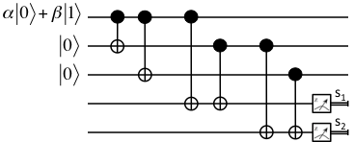
Putting it all Together to Correct a Bit Flip Error
How is error correction possible if: (i) can’t copy a qubit, (ii) can’t measure a qubit without collapsing it, (iii) must correct arbitrarily small errors?
      Use an entangled state, inspired by the classical repetition code
      Don’t measure the encoded logical qubit, measure syndromes to find the error:
X Error | Syndrome
top qubit | s₁=1, s₂=0
middle qubit | s₁=1, s₂=1
bottom qubit | s₁=0, s₂=1
no error | s₁=0, s₂=0

Slide 8

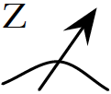

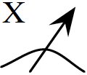
Topological Quantum Error Correction –
Surface Code Basics
d_{D}
Parity check detects X errors
d_{R}
d_{L}
d_{U}
s
a_{Z}
d_{D}
d_{R}
Parity check detects Z errors
d_{L}
d_{U}
s
a_{X}
- Four-qubit entangling measurements yield error syndromes
- Can correct X and Z errors independently, will only show X errors from now on

Slide 9
How do the Logical Operators Look Like? How can Error Decoding Fail?
X
Logical X operator
Z
Z
Z
Z
Z
X
Z
Logical Z operator
X
X
X
X
X
X
Harmless identity operator (trivial loop)
X
- Logical X and Z gates consist of single qubit X and Z on chains across the surface; code distance d=6
- These operations change the encoded state

Slide 10
Numerical Simulation of the Surface Code

Slide 11
Numerical Simulation – Step 1:
Introduce Errors and Measure Syndromes
X
X
Failed parity checks for X errors
X
X
Actual X errors
X
X
X
- Syndromes indicate presence of odd weight errors in the vicinity
- Must guess and correct errors next…

Slide 12
Numerical Simulation – Step 2:
Guess Errors and Determine Outcome
X
X
X
Failed parity checks for X errors
X
X
X
X
Actual X errors
X
X
X
X
Corrected X errors
X
- MWM heuristic corrects errors on chains between matched syndromes or syndromes and the boundary
- Succeeded with the errors on the top left but failed on the right! Logical X now acts on the encoded qubit!

Slide 13
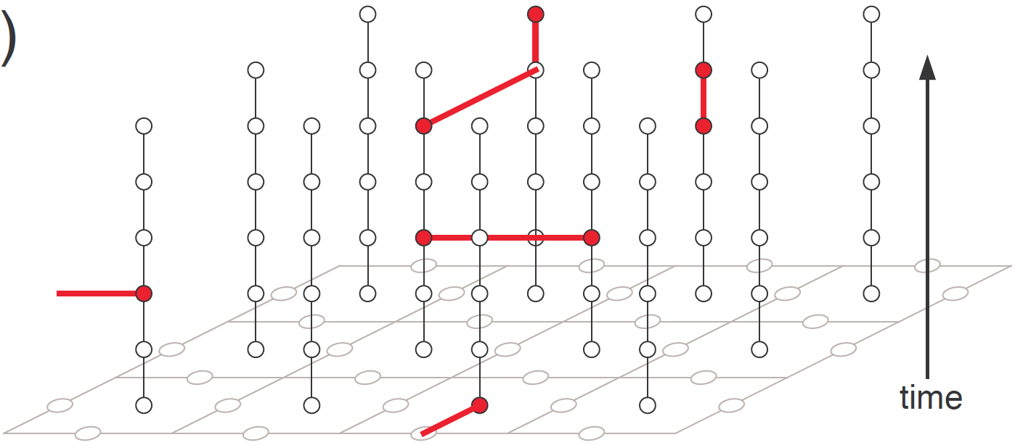
What if Some Syndrome Measurements Fail?
Repeat Syndrome Measurements!
measurement
error
X
measurement
error
X
X
X
- Syndromes are measured repeatedly, parity changes in time are marked as defects with
- Match pairs of nearby defects, correct errors in 2D on the physical qubits

Slide 14
Simulation with Three Different Error Models
Error Model: | Data qubit errors | Measurement gate errors | Syndrome extraction circuit errors
Code Capacity | yes | no | no
Phenomenological | yes | yes | no
Circuit | yes | yes | yes
- Monte Carlo simulation in C++
- Repeatedly generate and correct random errors
- Ability to simulate actions of quantum gates and propagation of X and Z errors

Slide 15
Code Capacity Error Model
Data qubit errors

Slide 16
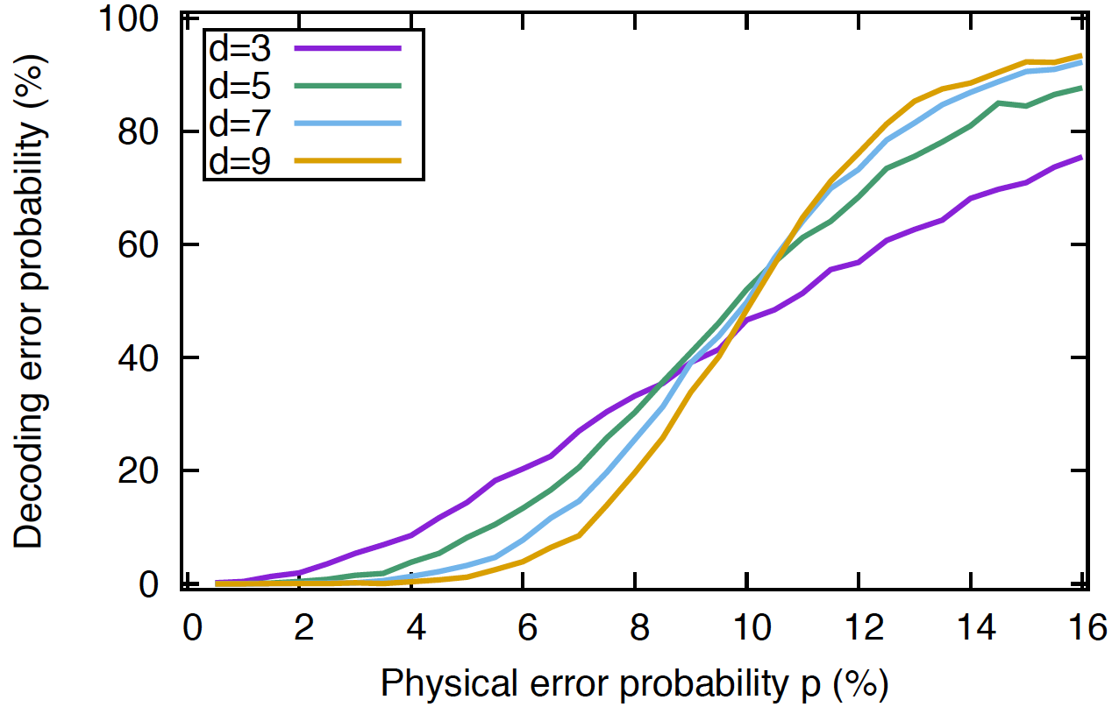
Code Capacity Error Model:
threshold
~ 10%

Slide 17
Phenomenological Error Model
Data qubit errors
Measurement gate errors

Slide 18
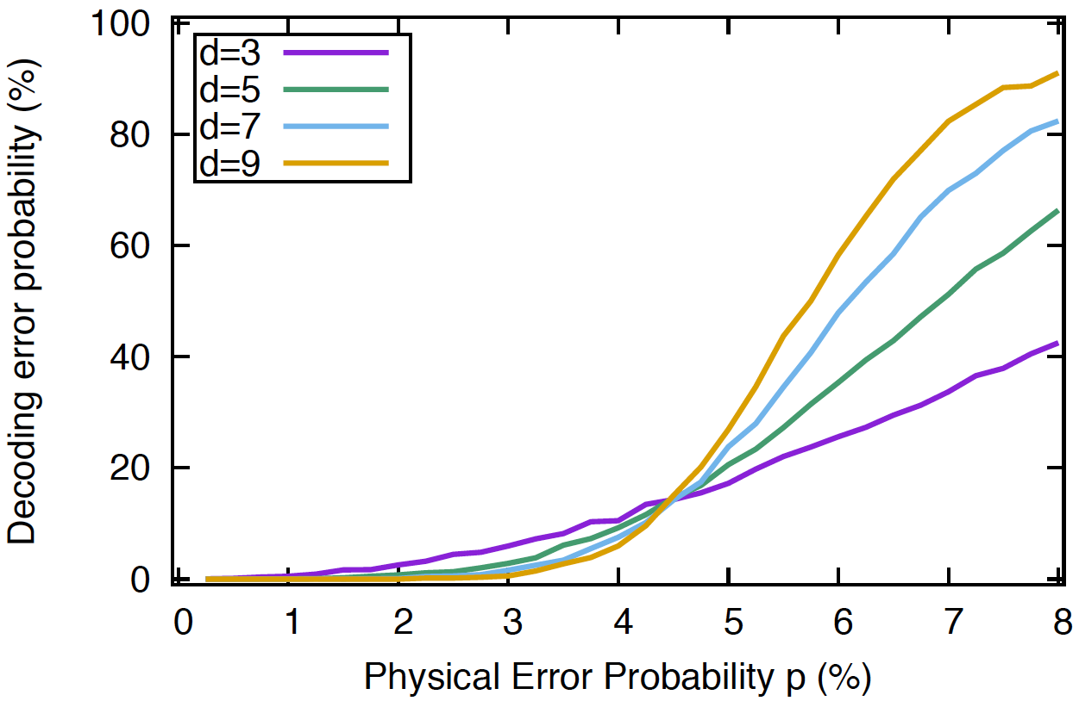
Phenomenological Error Model:
threshold
~ 4.5%

Slide 19
Circuit Error Model
Data qubit errors
Measurement gate errors
Syndrome extraction circuit errors

Slide 20
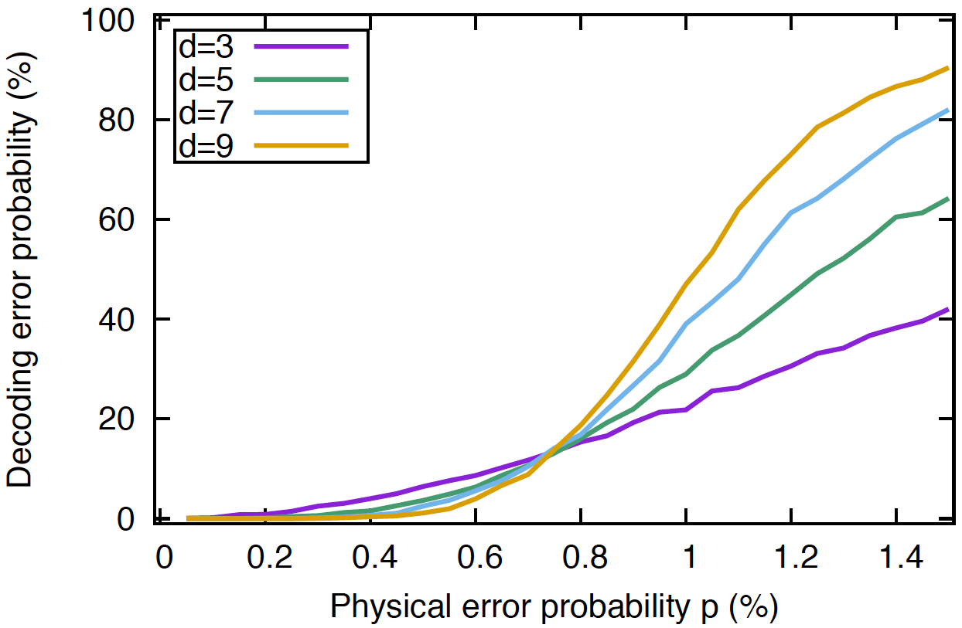
Circuit Error Model
threshold
~ 0.7%

Slide 21
Discussion and Future Directions

Slide 22
Possible Next Steps and Open Questions
- Physical properties of quantum channels
- Quantum key distribution: transmits a classical bit encoded into photon polarization in one of two bases
- Quantum teleportation: distributes an entangled qubit pair and two classical bits
- Most general model: transmits general quantum states
- Transmit quantum state vs. teleport with an entangled pair? What are the advantages and disadvantages?
- Comparison of parity checks on classical bits vs. entanglement distillation vs. full error correction?

