Slide 1
Traffic analysis and experimentation platform (TAEP)
Michael Jensen
SC17, November 13 2017

Slide 2
Motivation
Intelligent switching infrastructure through a programmable forwarding plane
Drawbacks of a traditional Ethernet switches include:
Inflexibility due to proprietary software dependence
Lack of a programmable forwarding plane
Barefoot Tofino Ethernet switches are user-programmable using P4 which enables:
Flexible network design
A programmable forwarding plane for analytics and network optimization

Slide 3
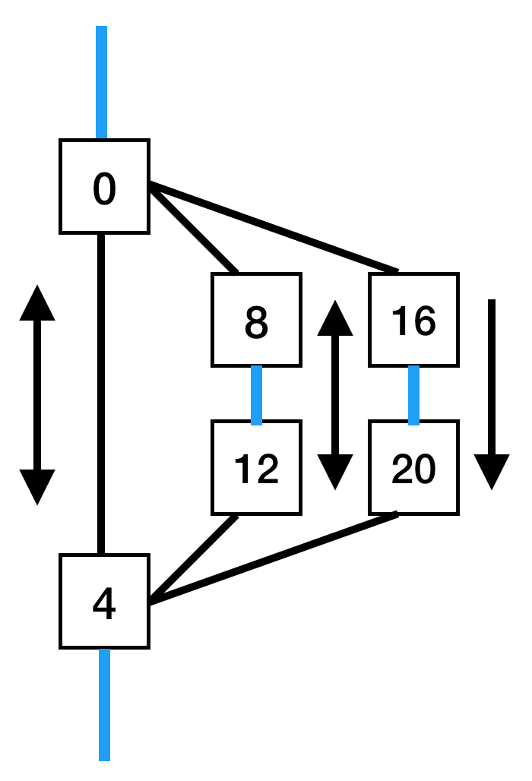
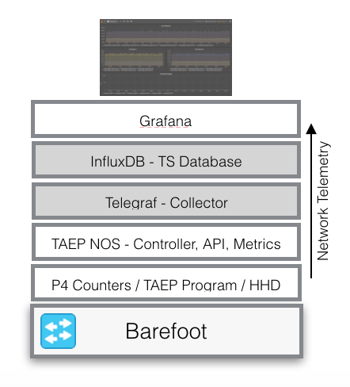
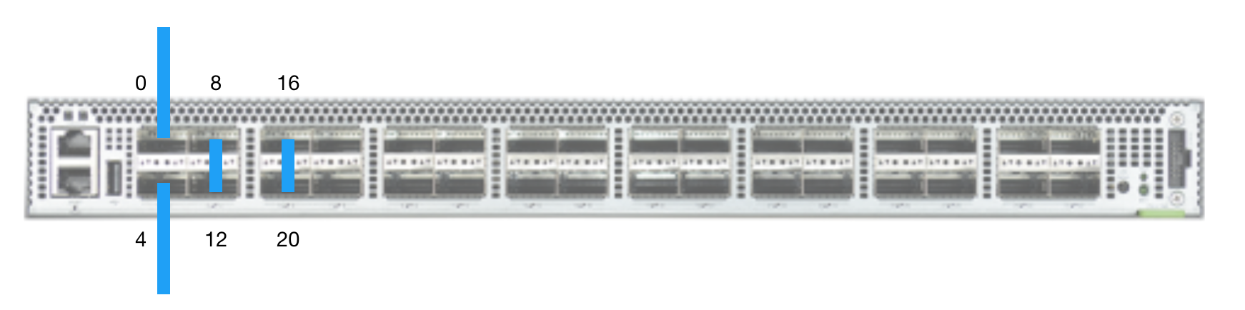
Applications
1. Traffic Analysis
Divert traffic from or to specific IPs and subnets of interest to a separate path
Analyze this traffic of interest using:
P4 counters and TAEP to record metrics such as packets in/out, source and destination, and octets in/out
InfluxDB to store time-series counter data
Grafana to graphically display time-series data
Traffic analysis can be used to collect data of interest and/or inform manual rerouting

Slide 4
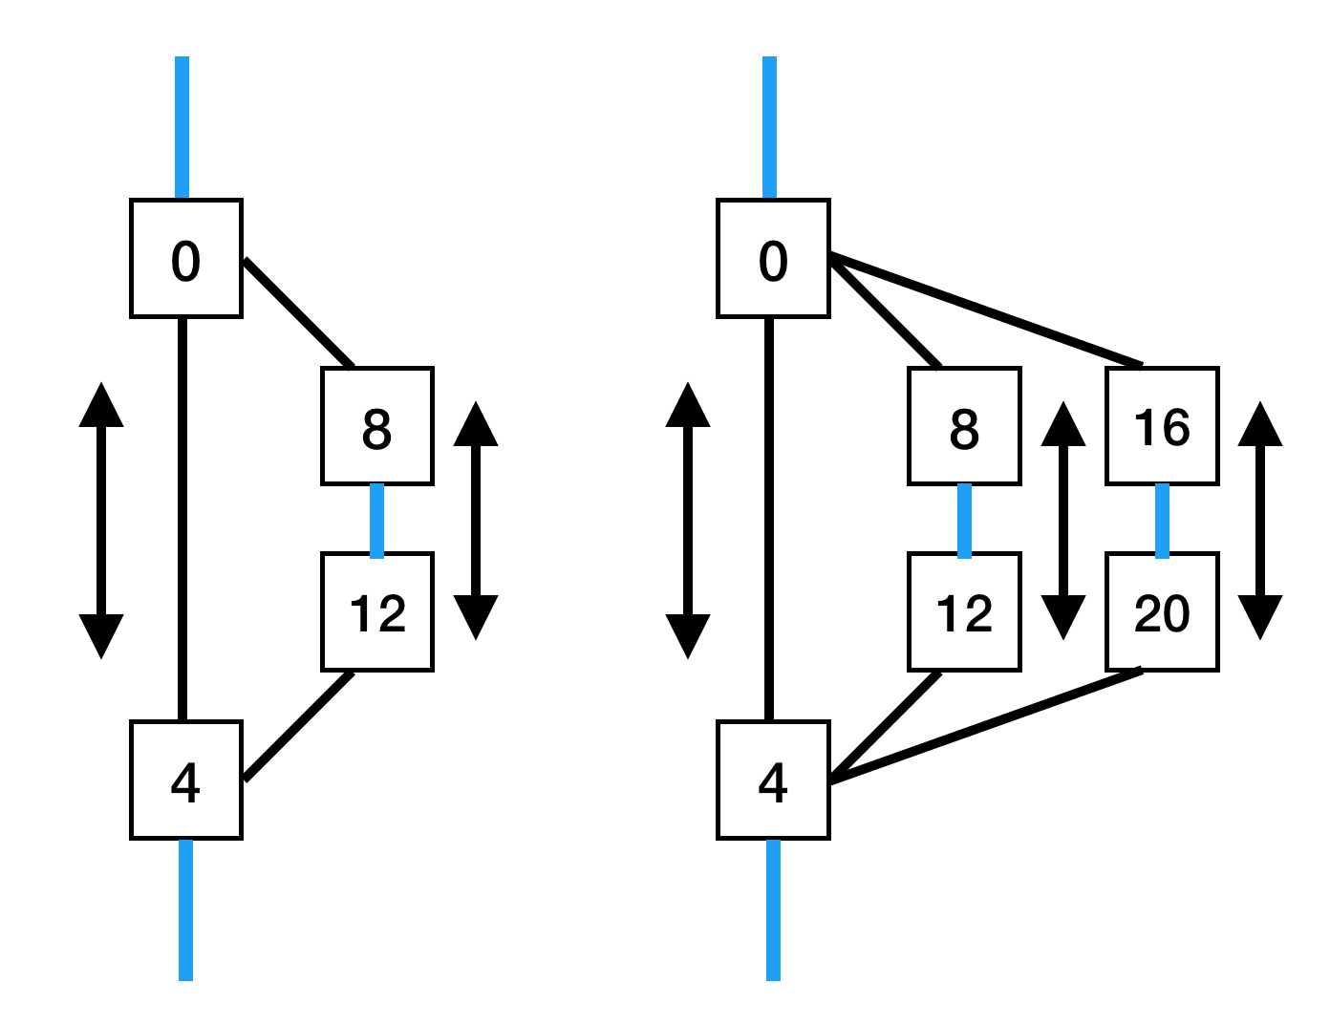
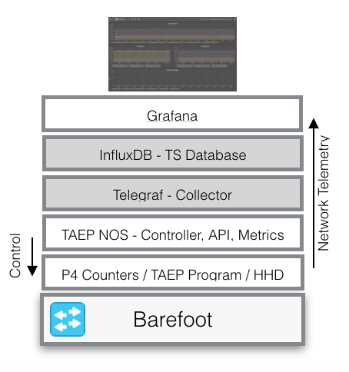
Applications
2. Heavy Hitter Detection And A/B Testing
Divert some or all traffic to HHD
Possible use cases include:
Track heavy traffic patterns
Compare the performance of different HHD algorithms
Use TAEP APIs to automatically reroute heavy flows

Slide 5
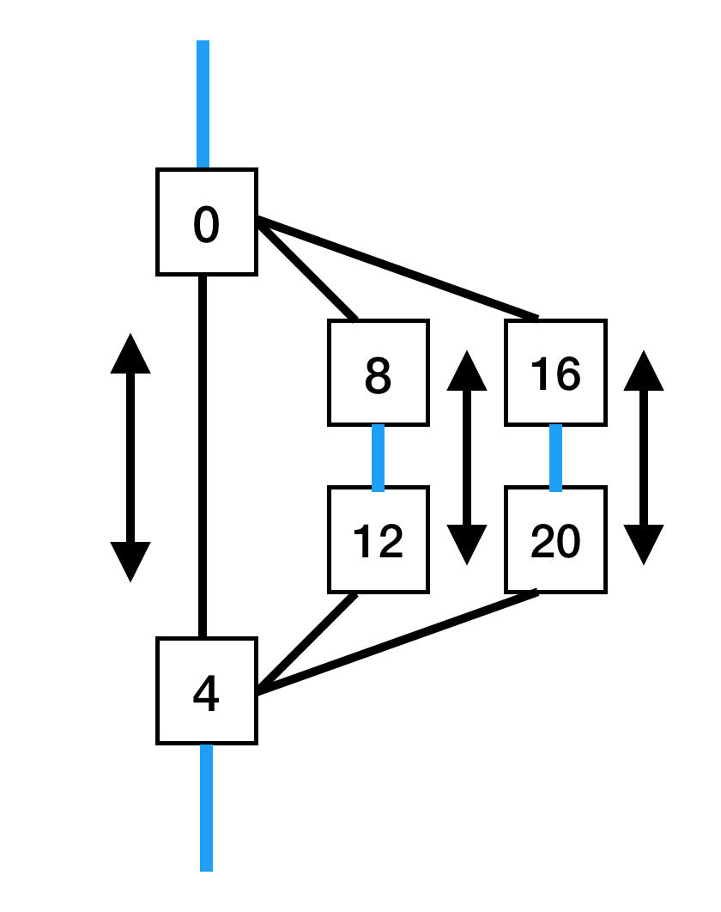
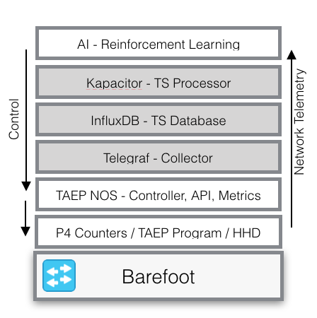
Applications
3. Control Traffic With Reinforcement Learning
Allow a reinforcement learning agent to manage traffic diversion using:
TAEP APIs
Kapacitor to pass measurements and trigger agent control
Possible use cases:
Traffic balancing*
Destination prioritization
Many more…

Slide 6
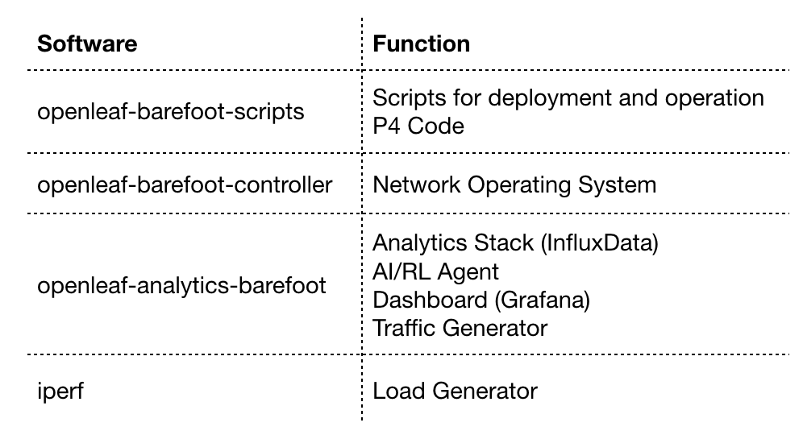
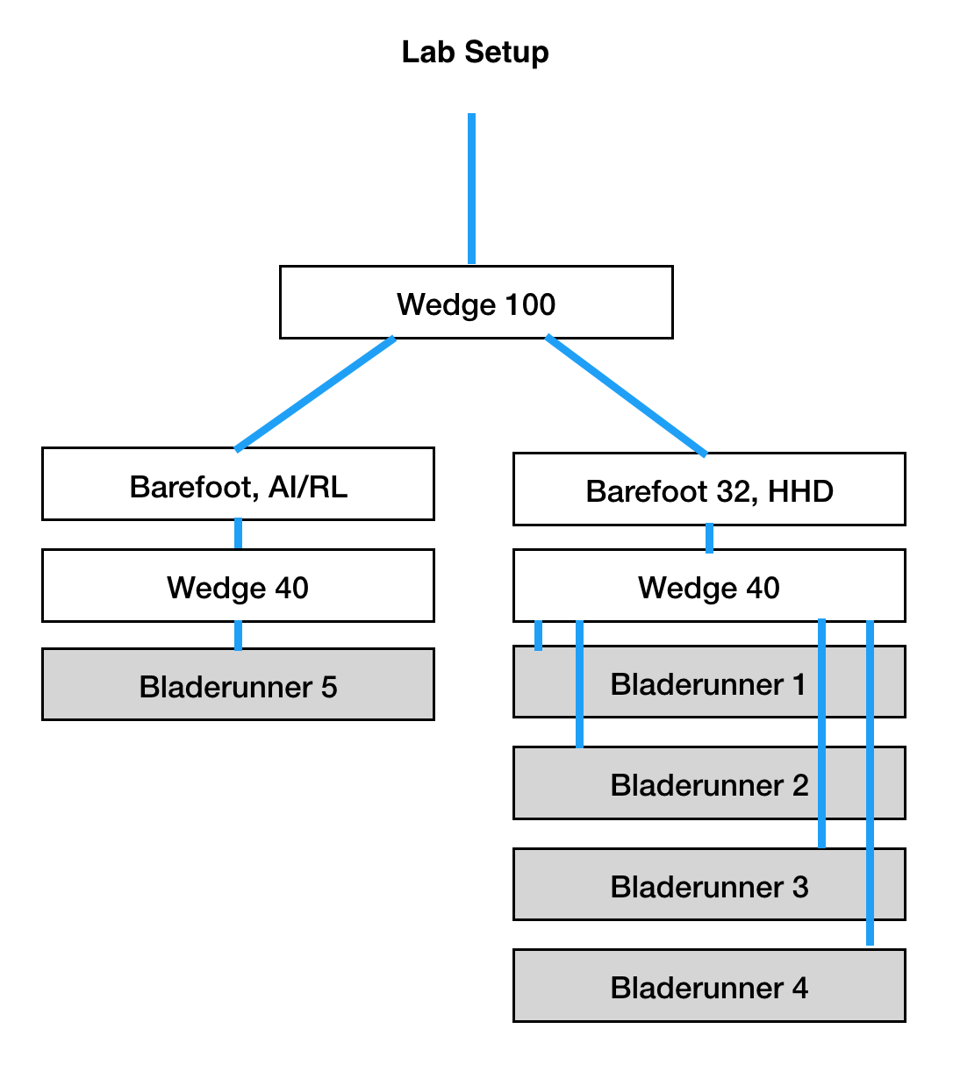
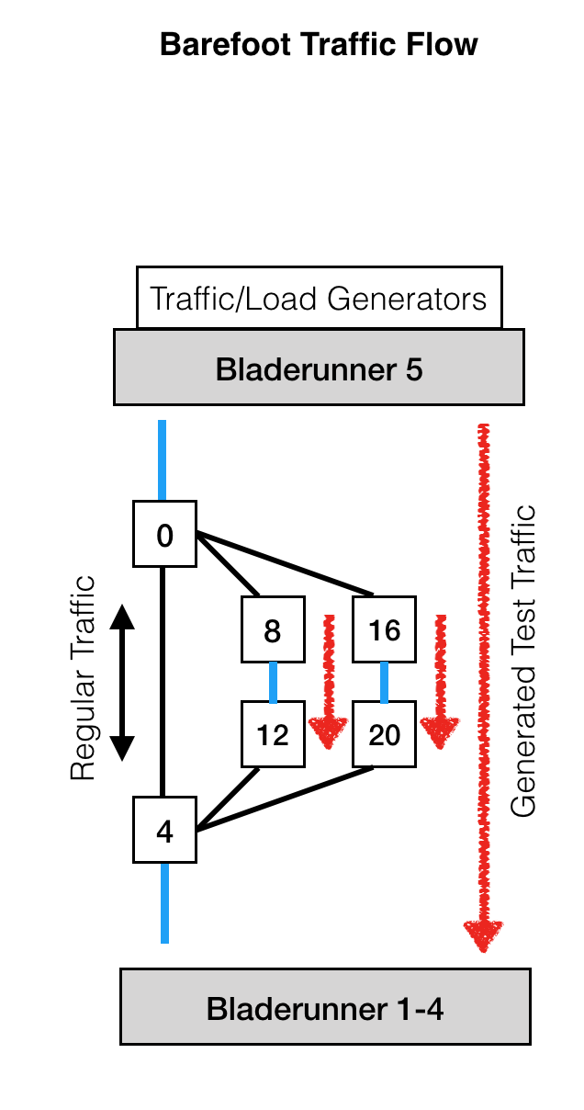
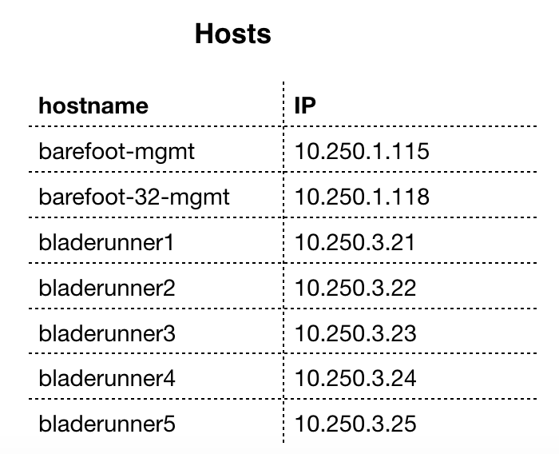
Demo Architecture

Slide 7
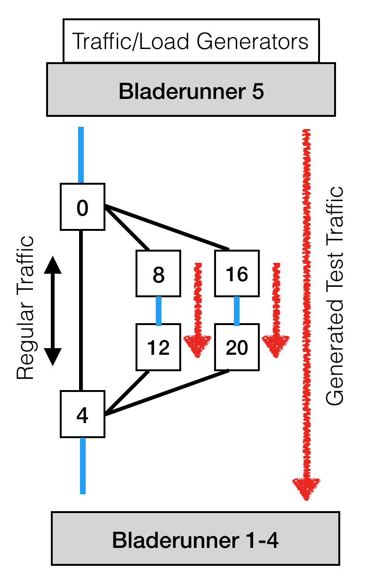
Demo
Heavy Hitter Detection and Redirection
Goal:
Use HHD algorithm to detect “heavier” flows
After 30 seconds, reroute the detected ”heavy” flow
Setup:
Divert all flows coming from bladerunner 5 through ports 8 and 12
Generate traffic with iperf between bladerunner 5 and bladerunners 1-4
Turn on HHD between ingress ports 12 and 20

Slide 8
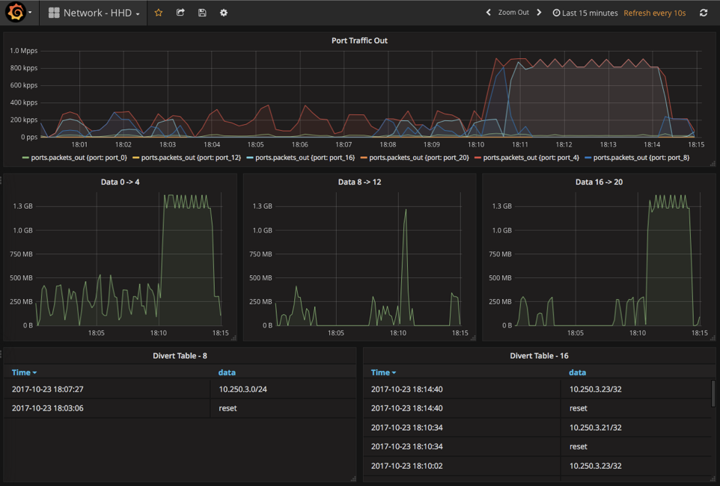
Results
Heavy Hitter Detection and Redirection

Slide 9
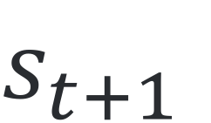
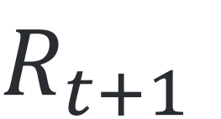
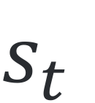
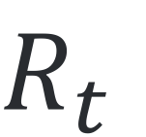
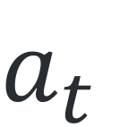
RL Summary
Reinforcement Learning Primer
State: The situation the agent is in
Rewards: A score that tells the agent how well it is achieving its goals
Policy: The plan for deciding which actions the agent will take in each situation
Action-Value Function: The value of taking an action in a given state.
Exploration vs Exploitation: Balance exploring to find the action value function with exploiting what the agent already knows to do well
Agent
$$R_{t}$$
$$s_{t}$$
$$a_{t}$$
$$s_{t+1}$$
Environment
$$R_{t+1}$$

Slide 10
Demo
Flow balancing with Reinforcement learning
Balance flows between routes 8-12 and 16-20 given:
A target flow ratio (use in our reward function)
A list of possible diversion routes (our action space)
Setup:
Start traffic generator
Start the python agent communicating with Kapacitor via a socket
Turn on HHD between ingress ports 12 and 20
Allow the agent to independently explore possible diversions (our action) and learn the optimal rules (our policy of which diversions to make in which situations)

Slide 11
Results
load balancing with Reinforcement learning

Slide 12
Future
Takeaways from TAEP
Intelligent switches with plane forwarding allow for:
Collecting data about traffic of interest
A/B testing on production traffic with minimal risk
Dynamically controlling traffic of interest

Slide 13
Acknowledgments
Marcel Neuhausler
Caltech and the Inqnet collaboration
The rest of the AT&T Foundry Team

