Slide 1
Network optimization
Presented by Oceane Bel and Kenneth Chang

Slide 2
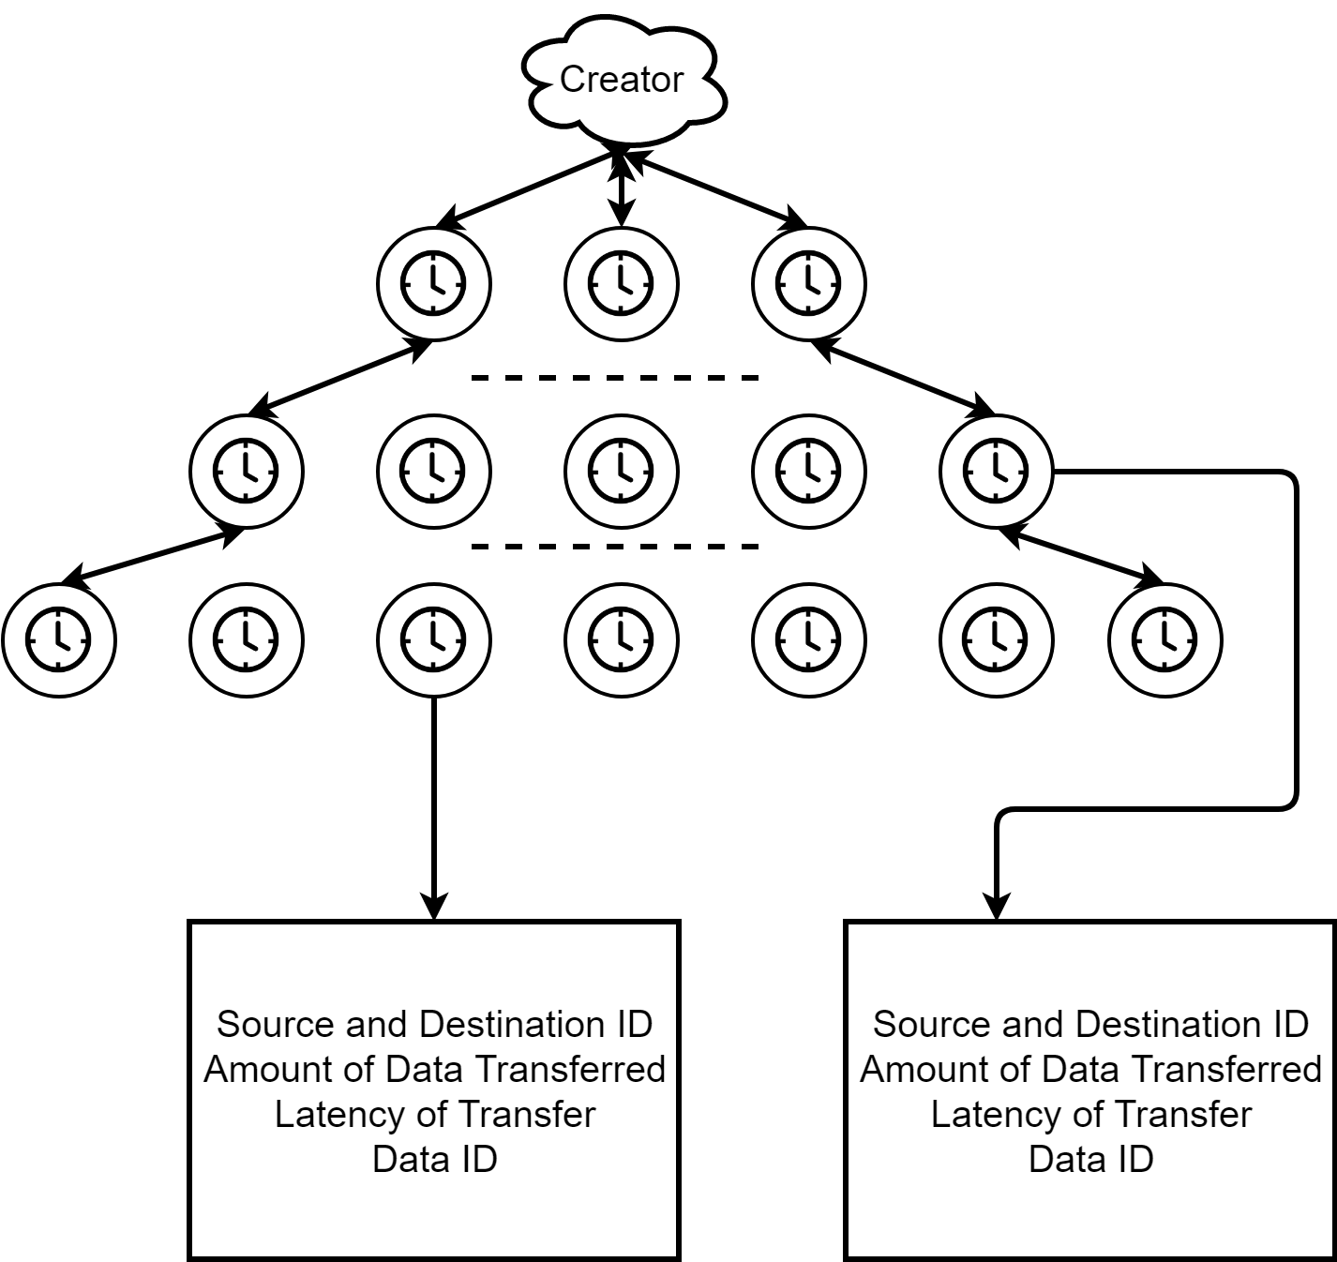
Gather data

Slide 3
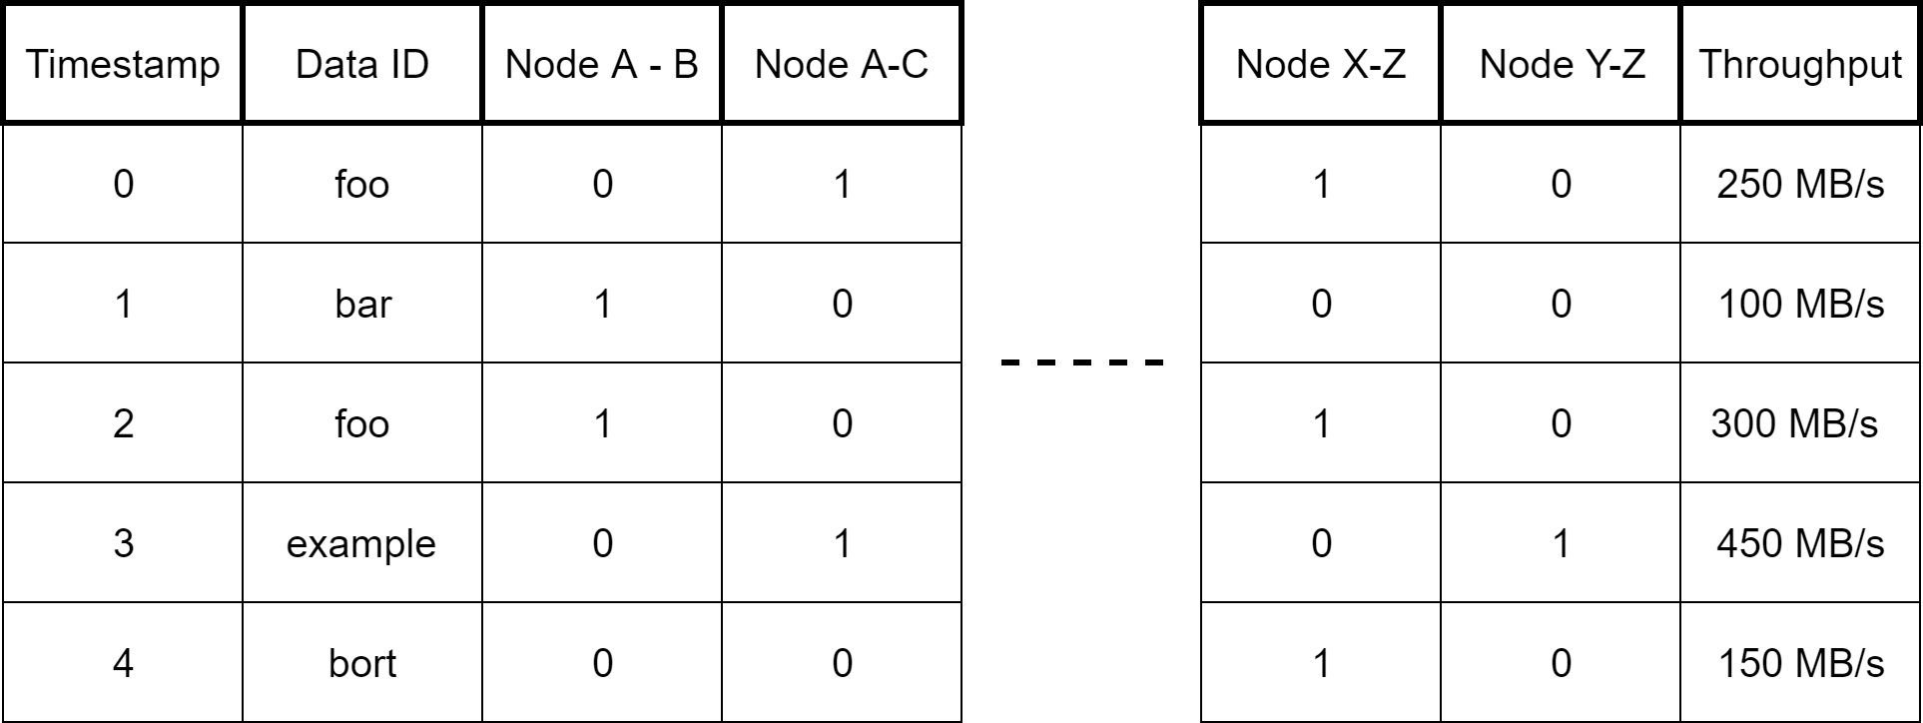
Replay DB

Slide 4
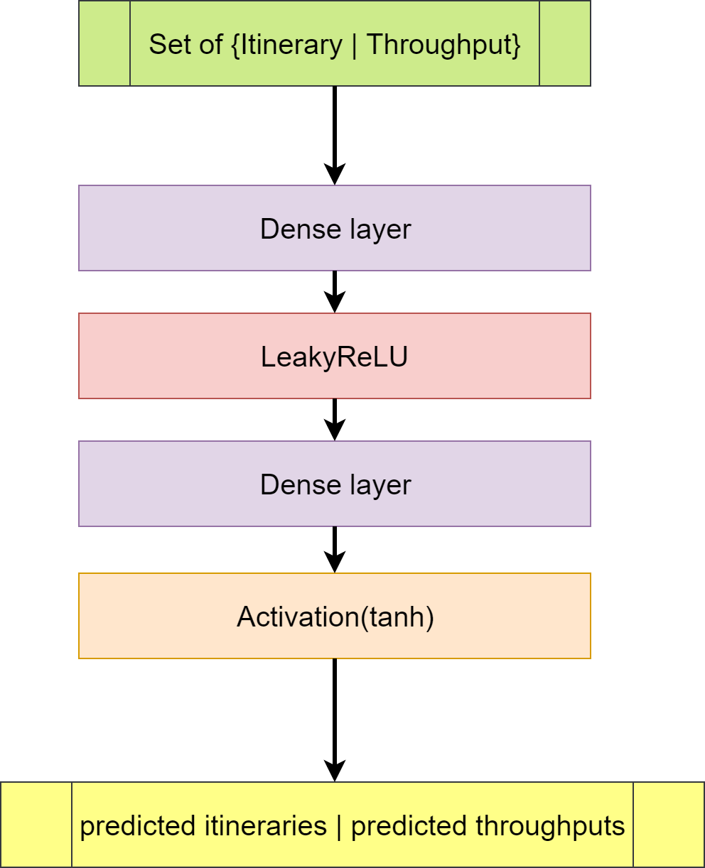
Neural Network

Slide 5
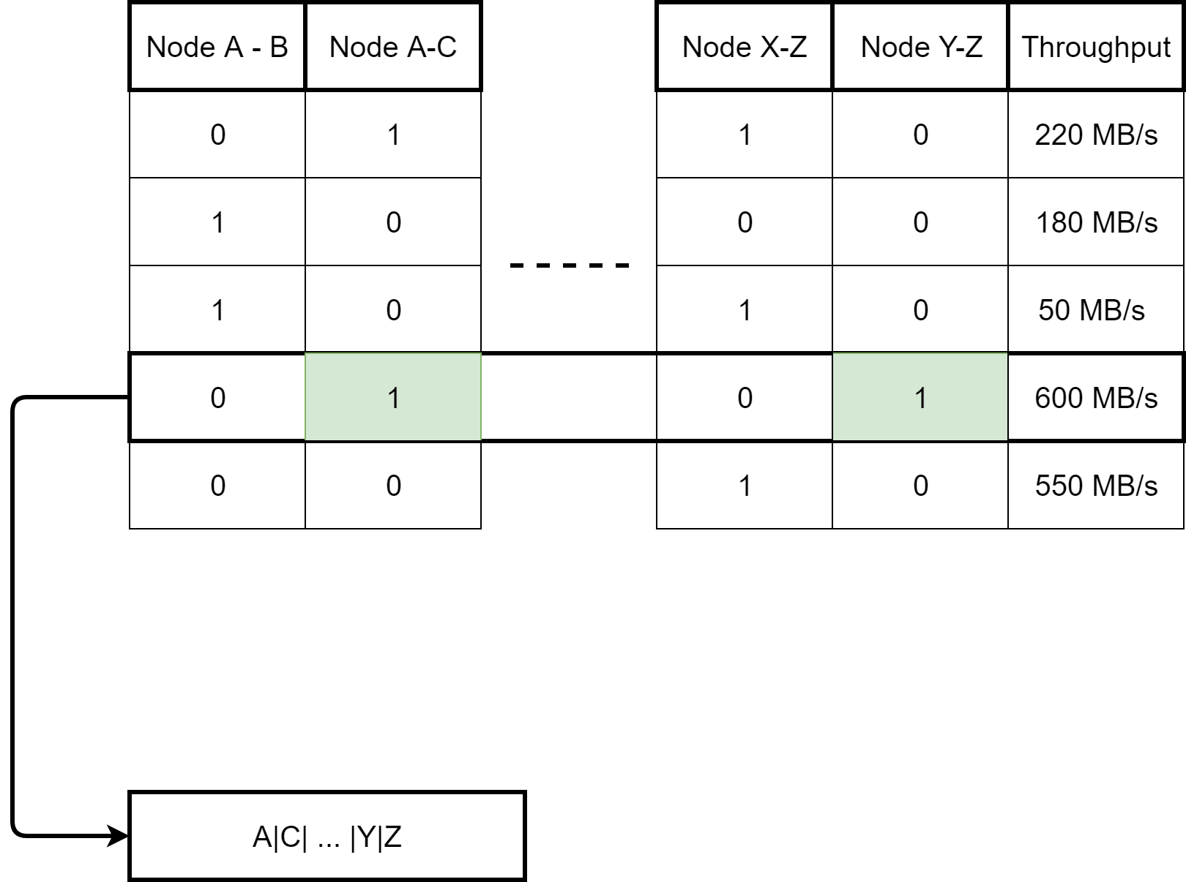
The predicted
data

Slide 6
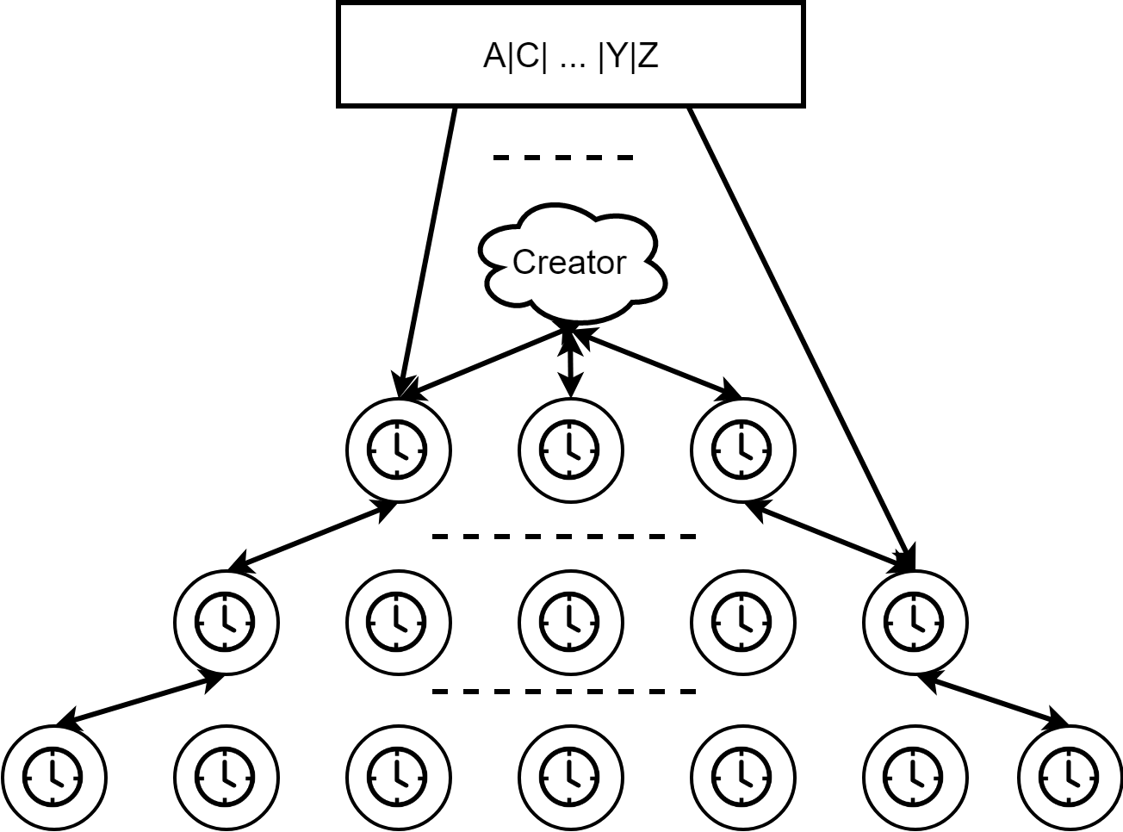
Applying changes

Slide 7

Questions?

