Slide 1
Fundamental Symmetry Violations with Polar Molecules
Nick Hutzler
Assistant Professor of Physics

Slide 2
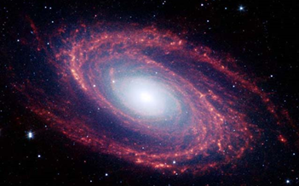
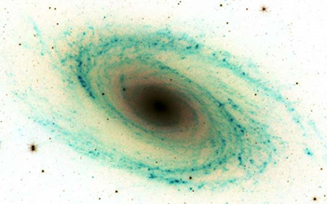
An Asymmetric Universe
The universe is made out of matter
  There is no free anti-matter in the universe
  What is anti-matter?
  How do we know this?
Problem: all known physical laws treat them equally
  (more or less)
  Where did matter come from?
  Where did anti-matter go?
  There must be processes that favor matter over anti-matter
Baryon Asymmetry of the Universe (BAU)
?

Slide 3
Theory of anything?
We have lots of work to do…
Everything we know and understand*
Normal Matter
Dark Matter
(Some ideas,
nothing yet)
Dark Energy
(No idea)
* No idea where it came from
* Most is too complex to fully describe

Slide 4
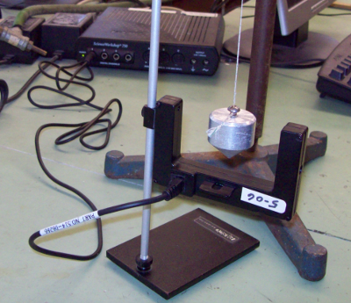
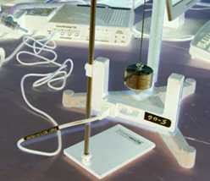
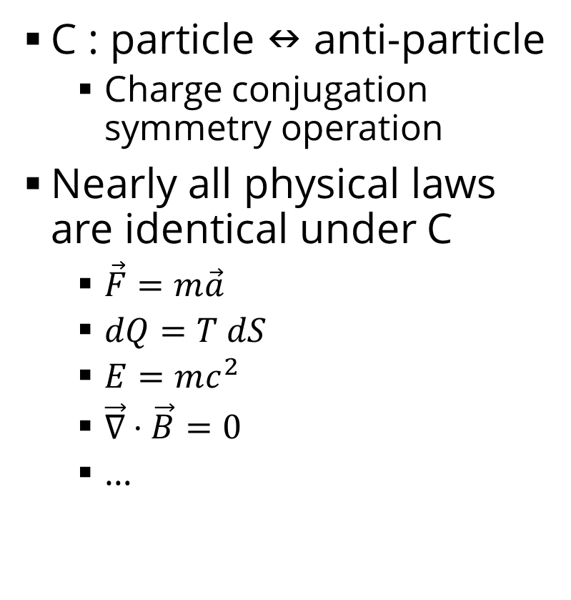
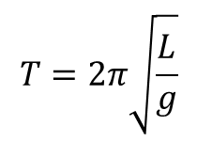
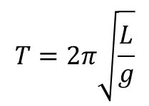
Symmetries
C : particle  anti-particle
  Charge conjugation symmetry operation
Nearly all physical laws are identical under C
  $\vec{F}=m\vec{a}$
  $dQ=T dS$
  $E=mc^{2}$
  $\vec{∇}⋅\vec{B}=0$
  …
$$T=2π\sqrt{\frac{L}{g}}$$
C “Mirror”
$$T=2π\sqrt{\frac{L}{g}}$$

Slide 5
Symmetries
If the universe was C symmetric, there could be no BAU!
Can relate to microscopic particle processes
  C-violating processes are necessary for the BAU
  Any process that creates matter would destroy anti-matter at the same rate
Let’s search for fundamental symmetry violations!
X
A
Y
C “Mirror”
X
A
Y

Slide 6
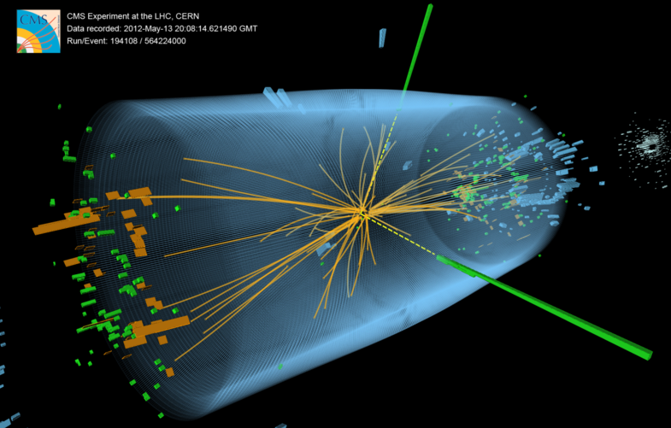
Searching for Symmetry Violation
“Direct” approach – see if new particles violate symmetries
  Make new particle at a collider like LHC
  Does this particle decay into more matter than anti-matter?
Active area of research, including at Caltech

Slide 7
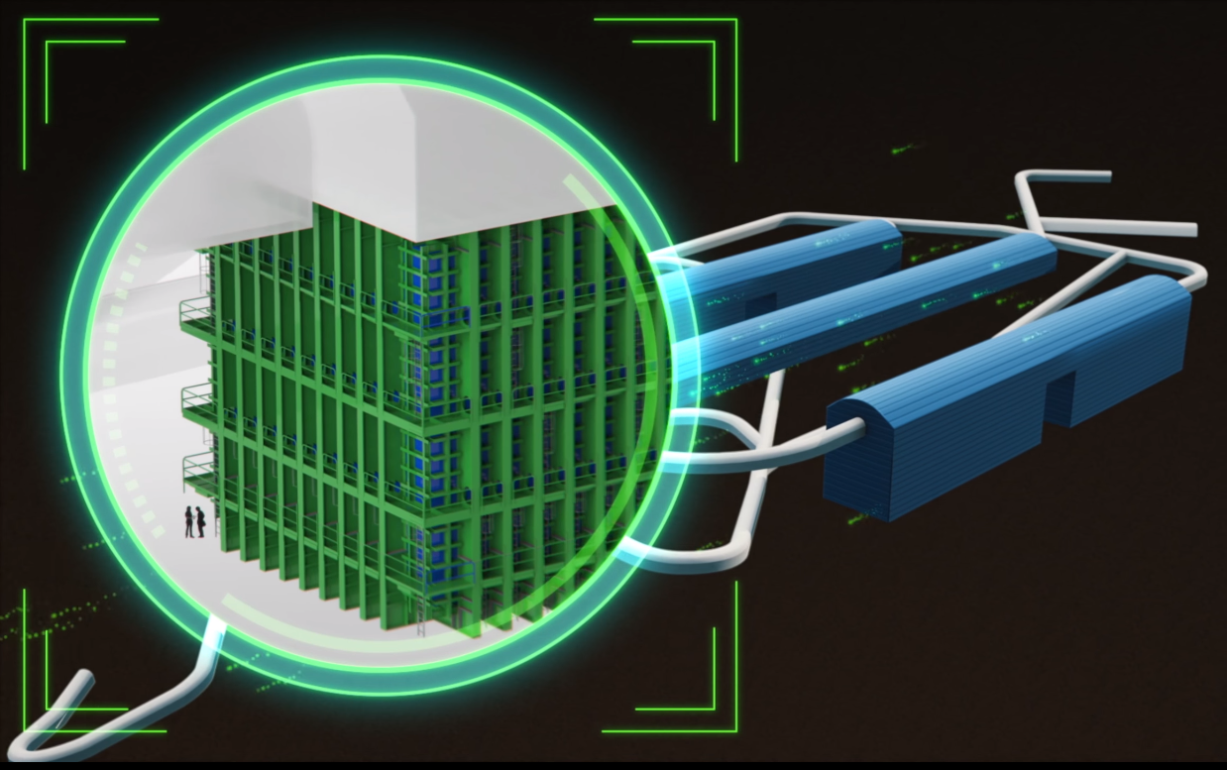
Searching for Symmetry Violation
“Indirect” approach – see if particles that we already know about violate these symmetries
  Neutrinos? Electrons? Nuclei? Neutrons?
  Looking for small effects
  Typically low energy, “precision measurements”
Active area of research, including at Caltech
  (This is what I do!)
DUNE Experiment

Slide 8
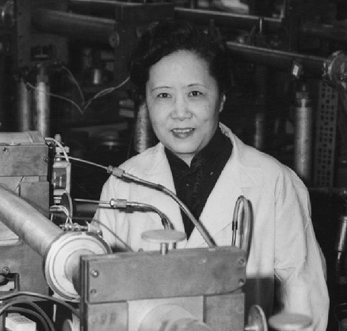


Symmetry Violations at Low Energy
Mirror
Parity symmetry
  P : (x, y, z) → (-x, -y, -z)
Weak nuclear force violates P symmetry!
  Only the weak force!*
Discovered experimentally in 1957 by Chen-Shiung Wu
Several other symmetries violations discovered later in other systems
$$T=2π\sqrt{L/g}$$
$$T=2π\sqrt{L/g}$$
Chien-Shiung Wu (吴健雄)
1912-1997
*So far…

Slide 9
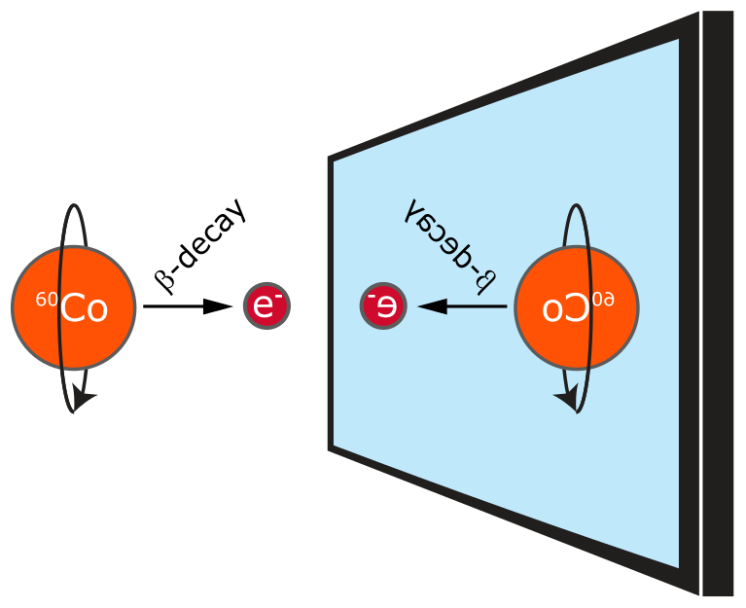


Parity Violation
$${}_{ }^{60}{Co → {}_{ }^{60}{Ni+e^{−}+{\overline{ν}}_{e}}}$$
β-decay : $n →p+e^{−}+{\overline{ν}}_{e}$
Question: What outcome would have shown that this process does not violate P?

Slide 10
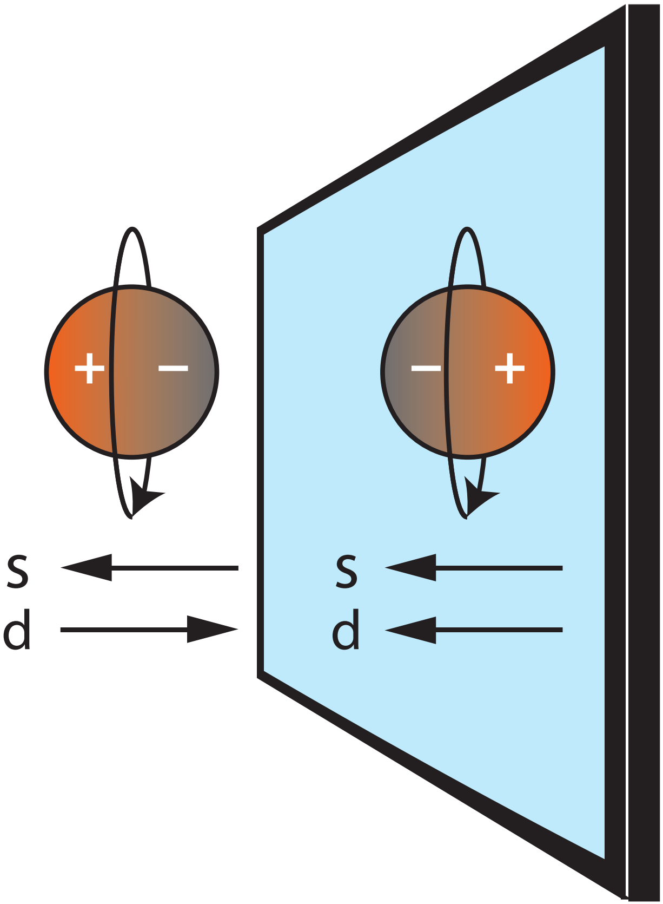
EDMs violate symmetries
≠
EDMs violate P… and more!
Violate the same symmetries needed to explain the BAU !
Must come from new high energy physics !!

Slide 11
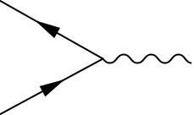
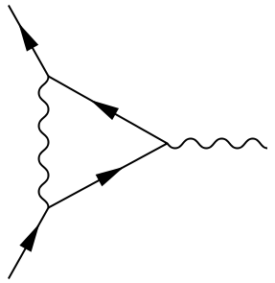
How does this happen?
How can high energy particles change “low energy” properties?
Two important ideas from quantum field theory
  Particles can be spontaneously created and destroyed
  Physical properties arise by summing over all possible interactions
“Feynman Diagrams”
“electron interacting with electromagnetic field”
γ
Time
e⁻
e⁻
+
+
Virtual photon
Virtual photon,
electron/positron
+ … (all other possibilities)

Slide 12
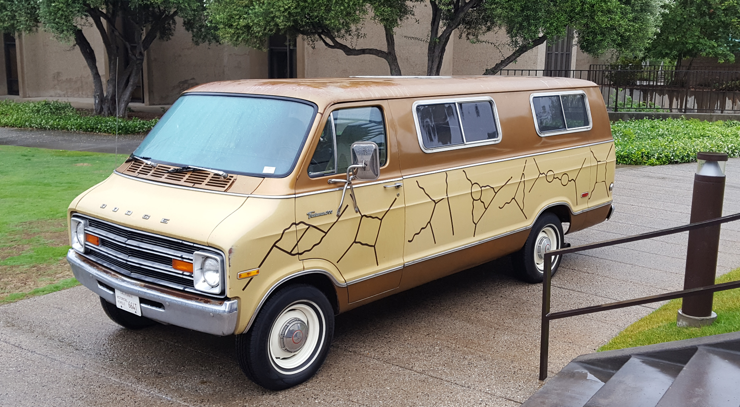
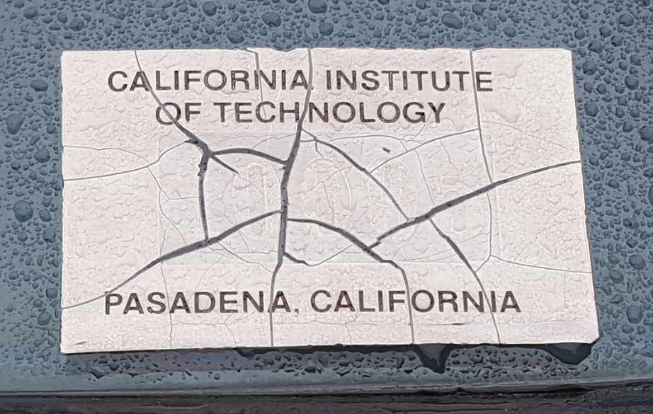

Slide 13
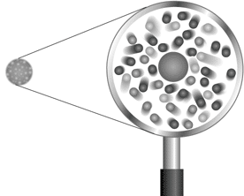
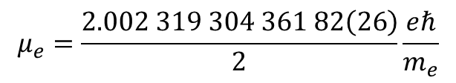
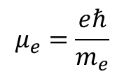
Electron magnetic moment
“Cloud of virtual particles around electron modifies its properties”
Before quantum electrodynamics: electron magnetic moment
Including “radiative corrections,” actually is
Shift in electro-magnetic properties of electron due to particle physics!
Photon
$$μ_{e}=\frac{eℏ}{m_{e}}$$
“Electron”
$$μ_{e}=\frac{2.002 319 304 361 82\left(26\right)}{2}\frac{eℏ}{m_{e}}$$

Slide 14
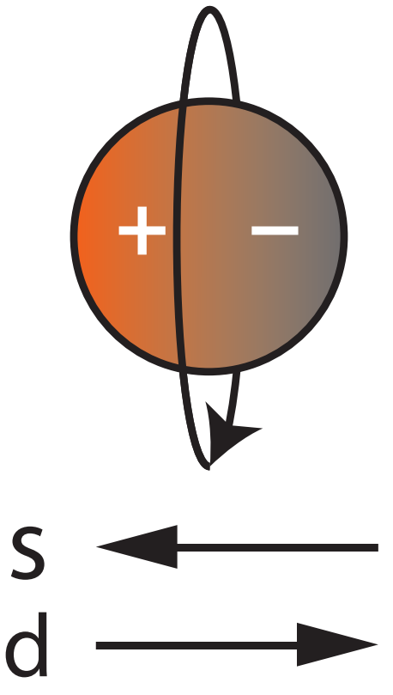
EDMs come from new particles
New symmetry-
violating particle!
Undiscovered particles will modify properties of regular particles as well
Symmetry-violating particles will induce permanent EDMs!
Effect is “very tiny,” requires precision measurement
New symmetry-violating particle!

Slide 15
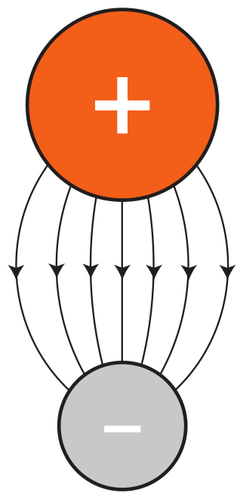
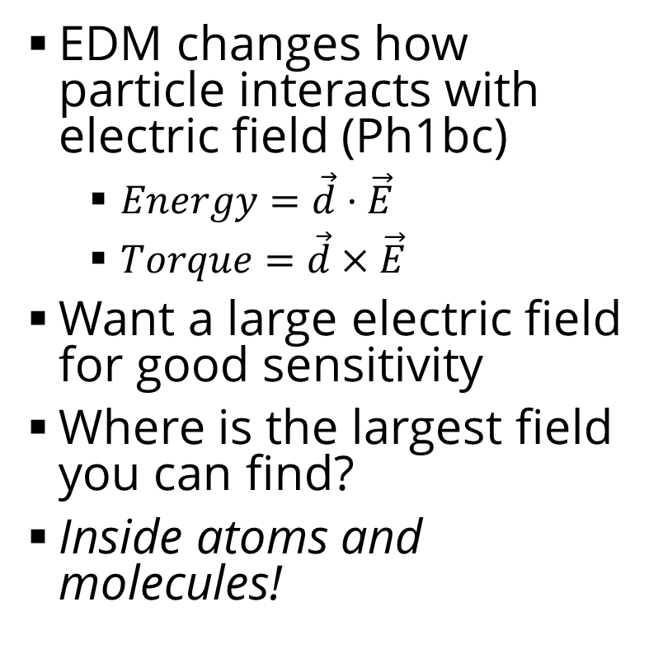
Let’s measure EDMs!
EDM changes how particle interacts with electric field (Ph1bc)
  $Energy=\vec{d}⋅\vec{E}$
  $Torque=\vec{d}×\vec{E}$
Want a large electric field for good sensitivity
Where is the largest field you can find?
Inside atoms and molecules!

Slide 16
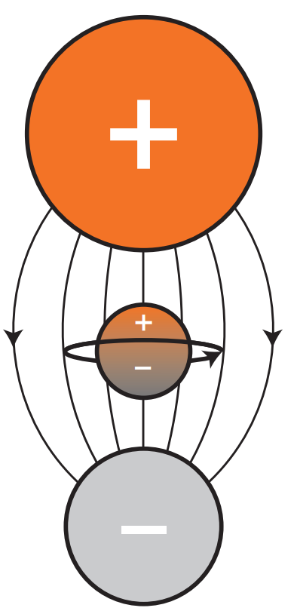
How large is the field?
Let’s do a simple estimate
  E ~ charge/(distance)²
  Charge ~ electron charge
  Distance ~ Bohr radius
  E ~ 1-100 Gigavolt/cm
“Largest” lab field is
~100 kV/cm
  ~ million times larger than lab fields
Study the effect on the molecular constituents!

Slide 17
How large is the field?
Let’s do a simple estimate
  E = charge x distance
  Charge ~ electron charge
  Distance ~ Bohr radius
  E ~ 1-100 Gigavolt/cm
“Largest” lab field is
~100 kV/cm
  ~ million times larger than lab fields
Study the effect on the molecular constituents!
Valence
electron

Slide 18
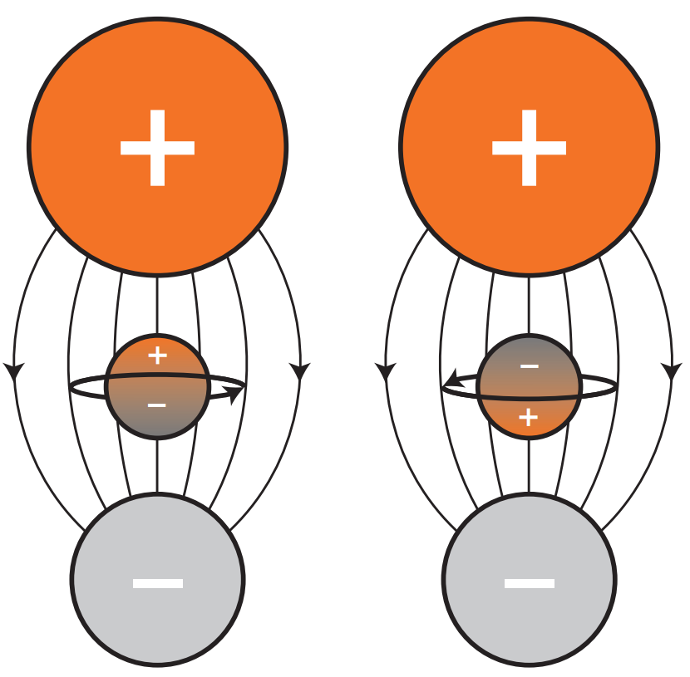
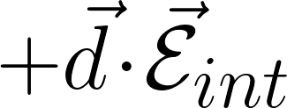
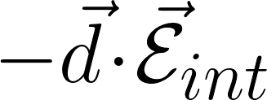
How to measure
Flip particle around (electron, for example)
Look for energy shifts
  For example, electron interacting with internal electric field
Desired signal is symmetry-violating
  Can’t arise from “regular” sources
  Not looking for tiny deviation from a calculation
This approach requires full control over the molecule

Slide 19
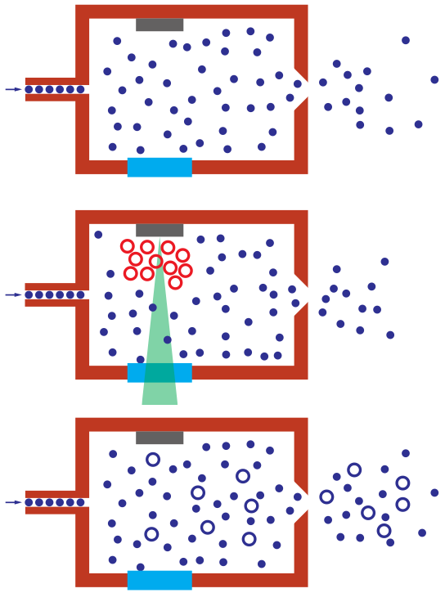
Cooling molecules
Solid precursor
4 K cell
First step – cool them
  Why?
Technique: cryogenic buffer gas cooling
  Use collisions with cold, inert buffer gas (Helium)
  Around 4 K is sufficient
Create beam (CBGB) to extract molecules into measurement region
  Why not do measurement in cryogenic cell?
He in
Cold He
Window
Hot
molecules
Pulsed laser
Cold
molecules
Cold
molecules

Slide 20
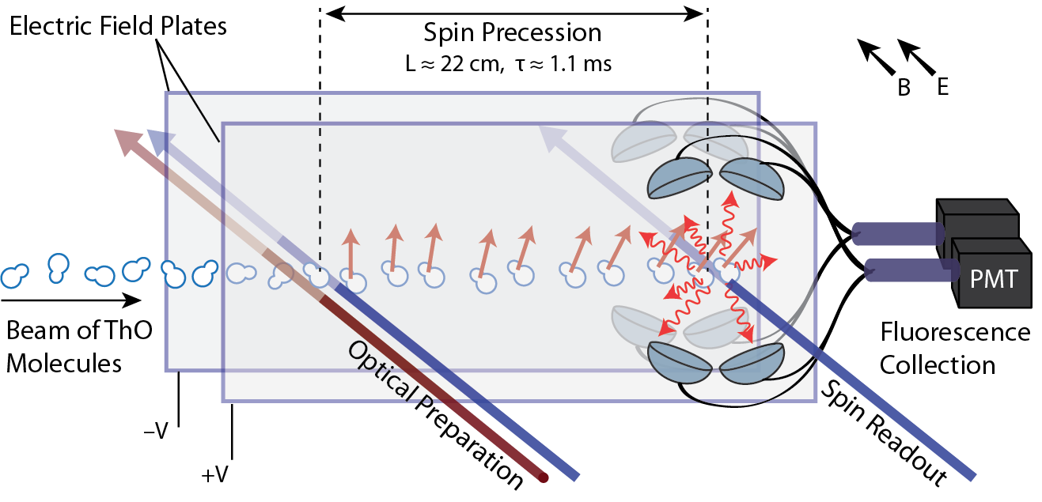
Apparatus Overview
CBGB

Slide 21
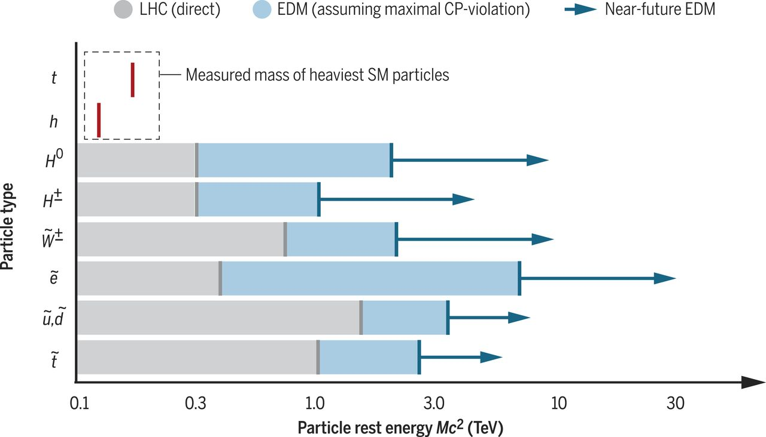
How sensitive?
Precision searches are already probing beyond the reach of the LHC
  State of the art: ~10 TeV
  ~10x beyond LHC
  Complementary
  Already exploring interesting BAU territory
Let’s keep pushing!
  Higher energy
  More sources

Slide 22
Many Sources
e
q
eEDM
qEDM
πNN
q
e-N
q
CEDM
NEDM

Slide 23
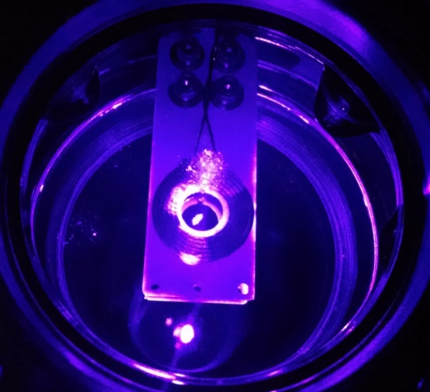
Laser cooling and trapping
User lasers to cool atoms, molecules to <mK temperatures
Trap for many seconds
Extreme sensitivity!
Laser cooled molecules could extend sensitivity to 1,000 TeV scale
Really interesting, take Ph137a!

Slide 24
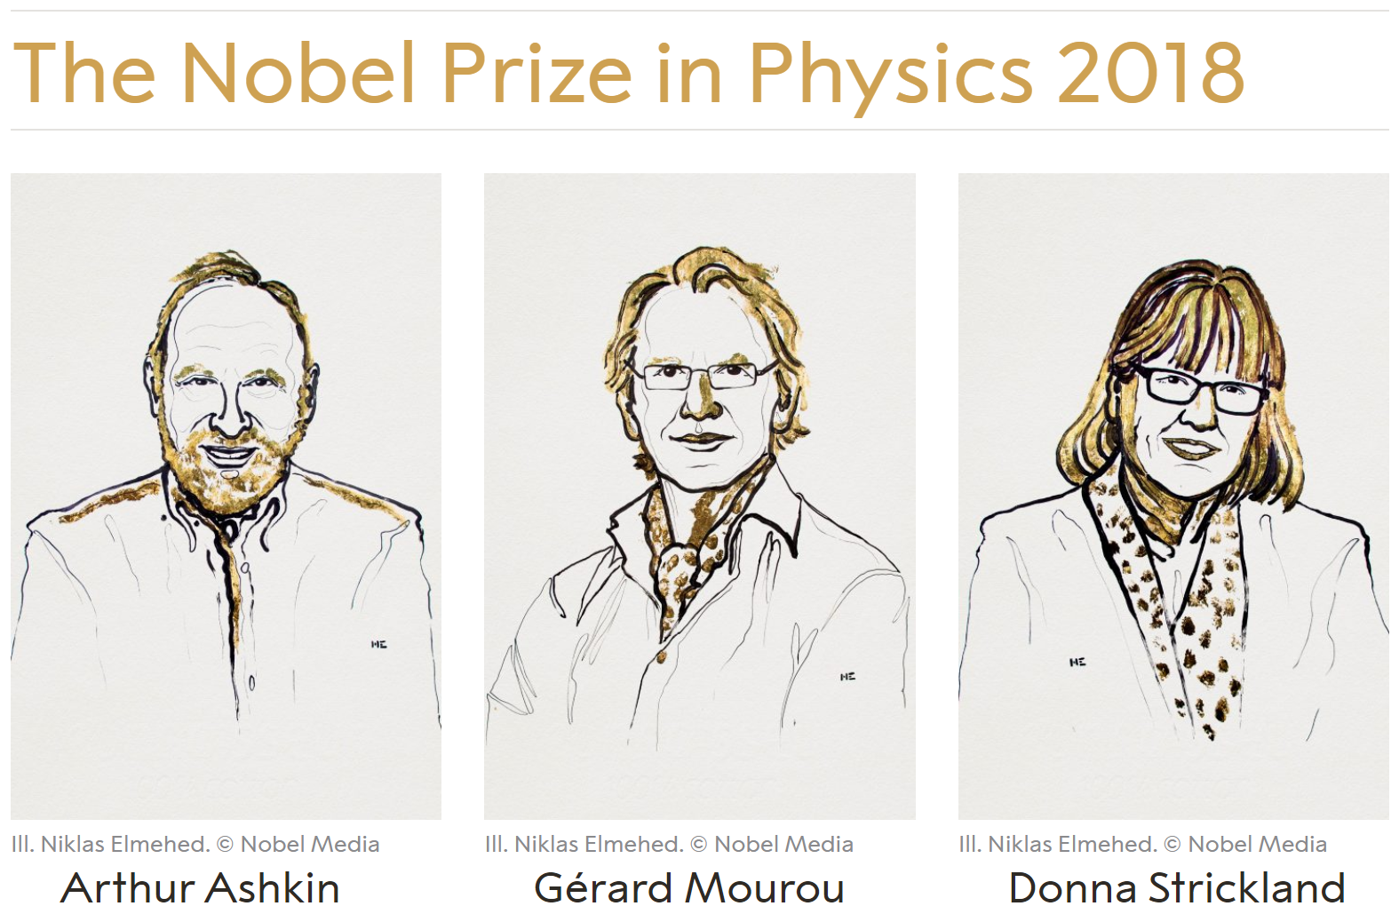
Optical tweezers
Generation of ultrafast laser pulses

Slide 25
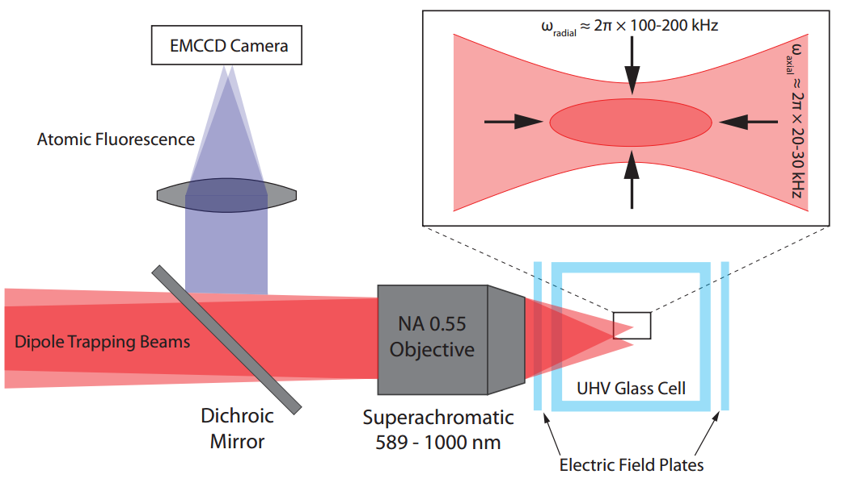
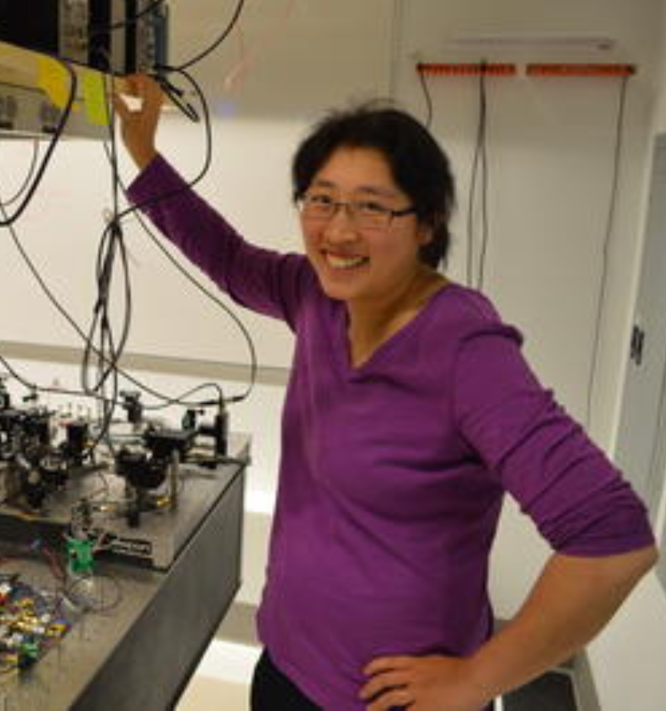
Aside: Optical Tweezers
Flashback slide! From my post-doc with Kang-Kuen Ni @ Harvard

Slide 26

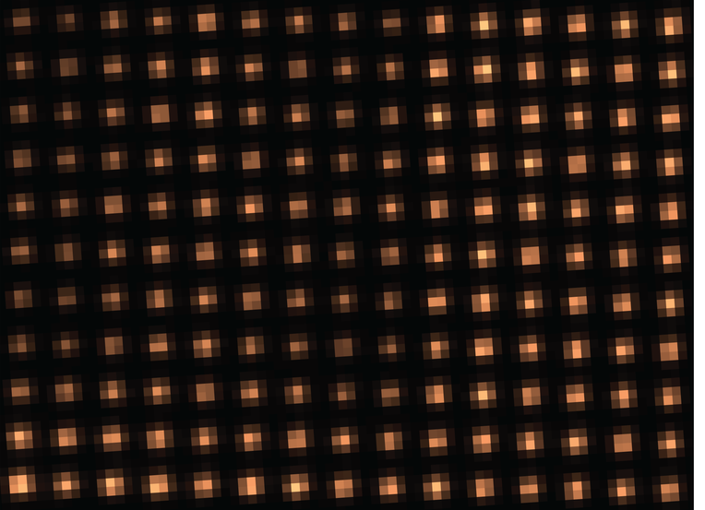
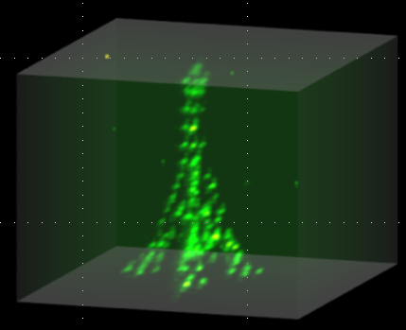
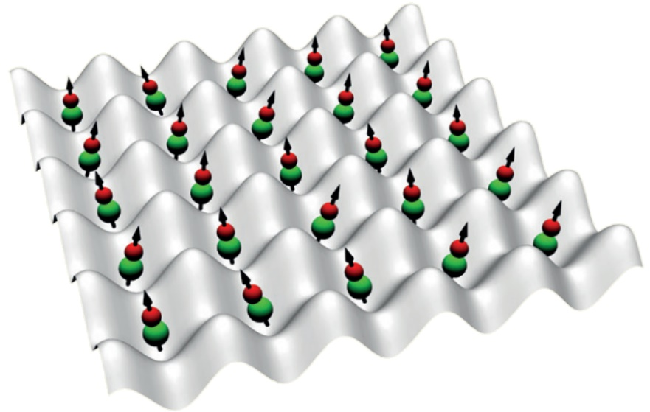
Single Na atom
Kang-Kuen Ni @ Harvard
Array of Sr Atoms
Manuel Endres @ Caltech
Eiffel Tower of Rb Atoms
Antoine Browaeys @ Paris
Optical tweezers offer total control over all degrees of freedom, including spatial
What we are trying to do!

Slide 27
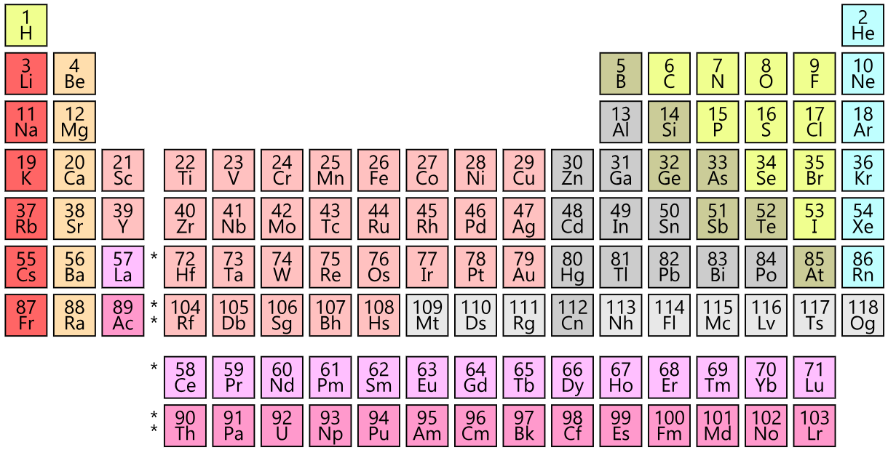
Our molecule: YbOH

Slide 28

Our molecule: YbOH
YbOH is neat!
  Great sensitivity to symmetry violation in nucleus, electron
  Laser-coolable via strong optical transitions
  Robust against experimental errors
Polyatomic molecules are unique – neither diatomics nor atoms offer all of these
O
H
Yb

Slide 29
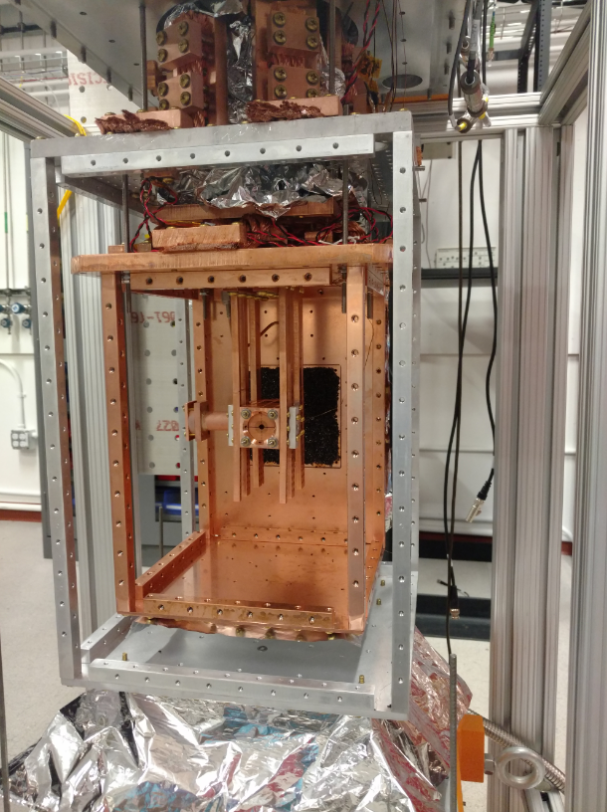
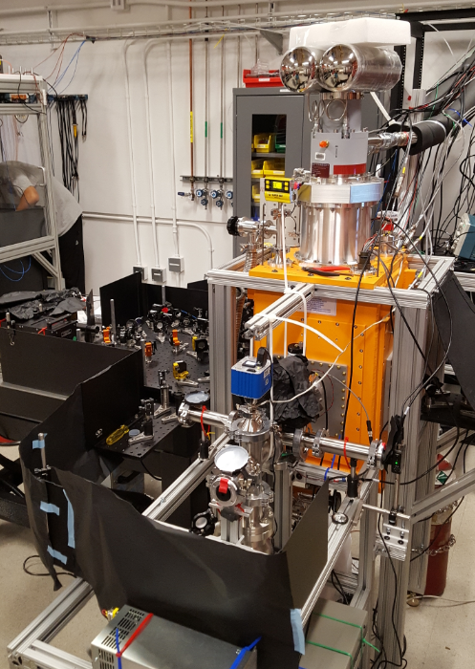
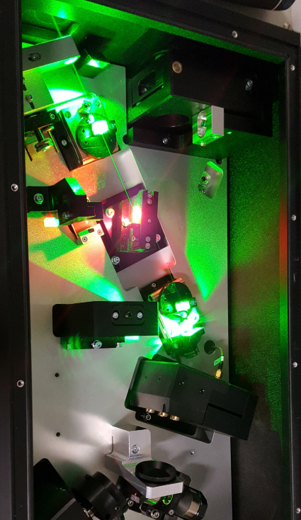
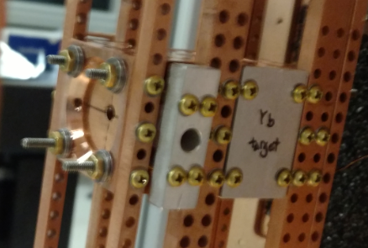
Come visit! First floor, Downs-Lauritsen

Slide 30
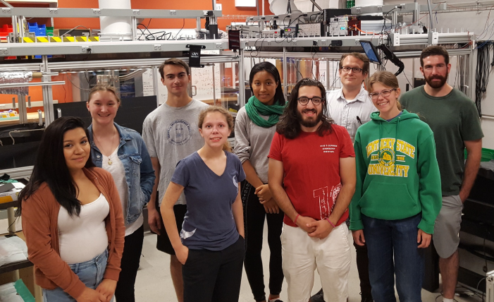
The group: Summer 2018
www.hutzlerlab.com

Slide 31
Questions?

