Slide 1
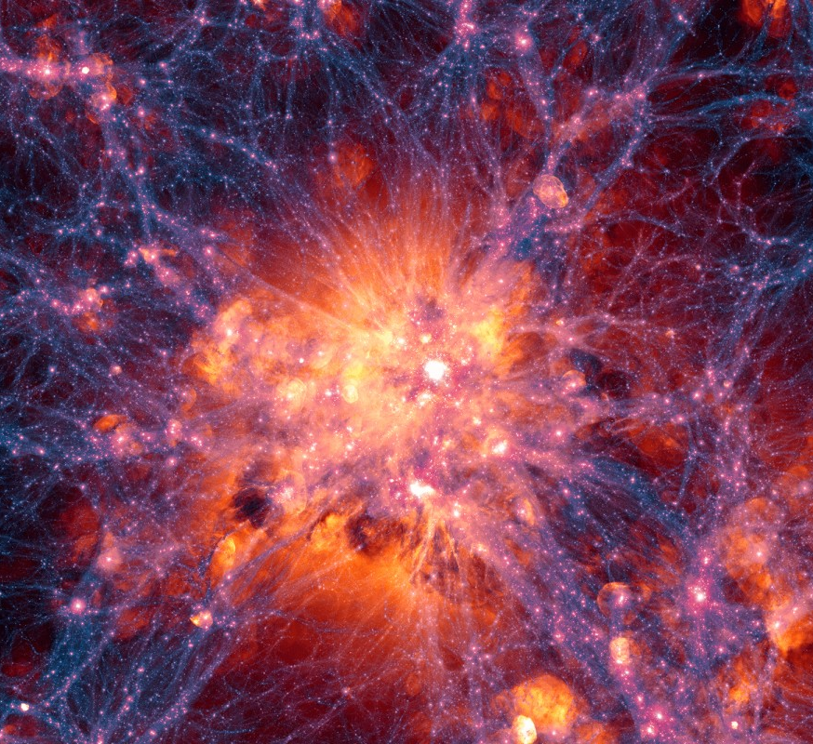
Project Update
n-type Gallium Arsenide / SNSPDs for Direct Dark Matter Detection
Jamie Luskin
December 22, 2020

Slide 2
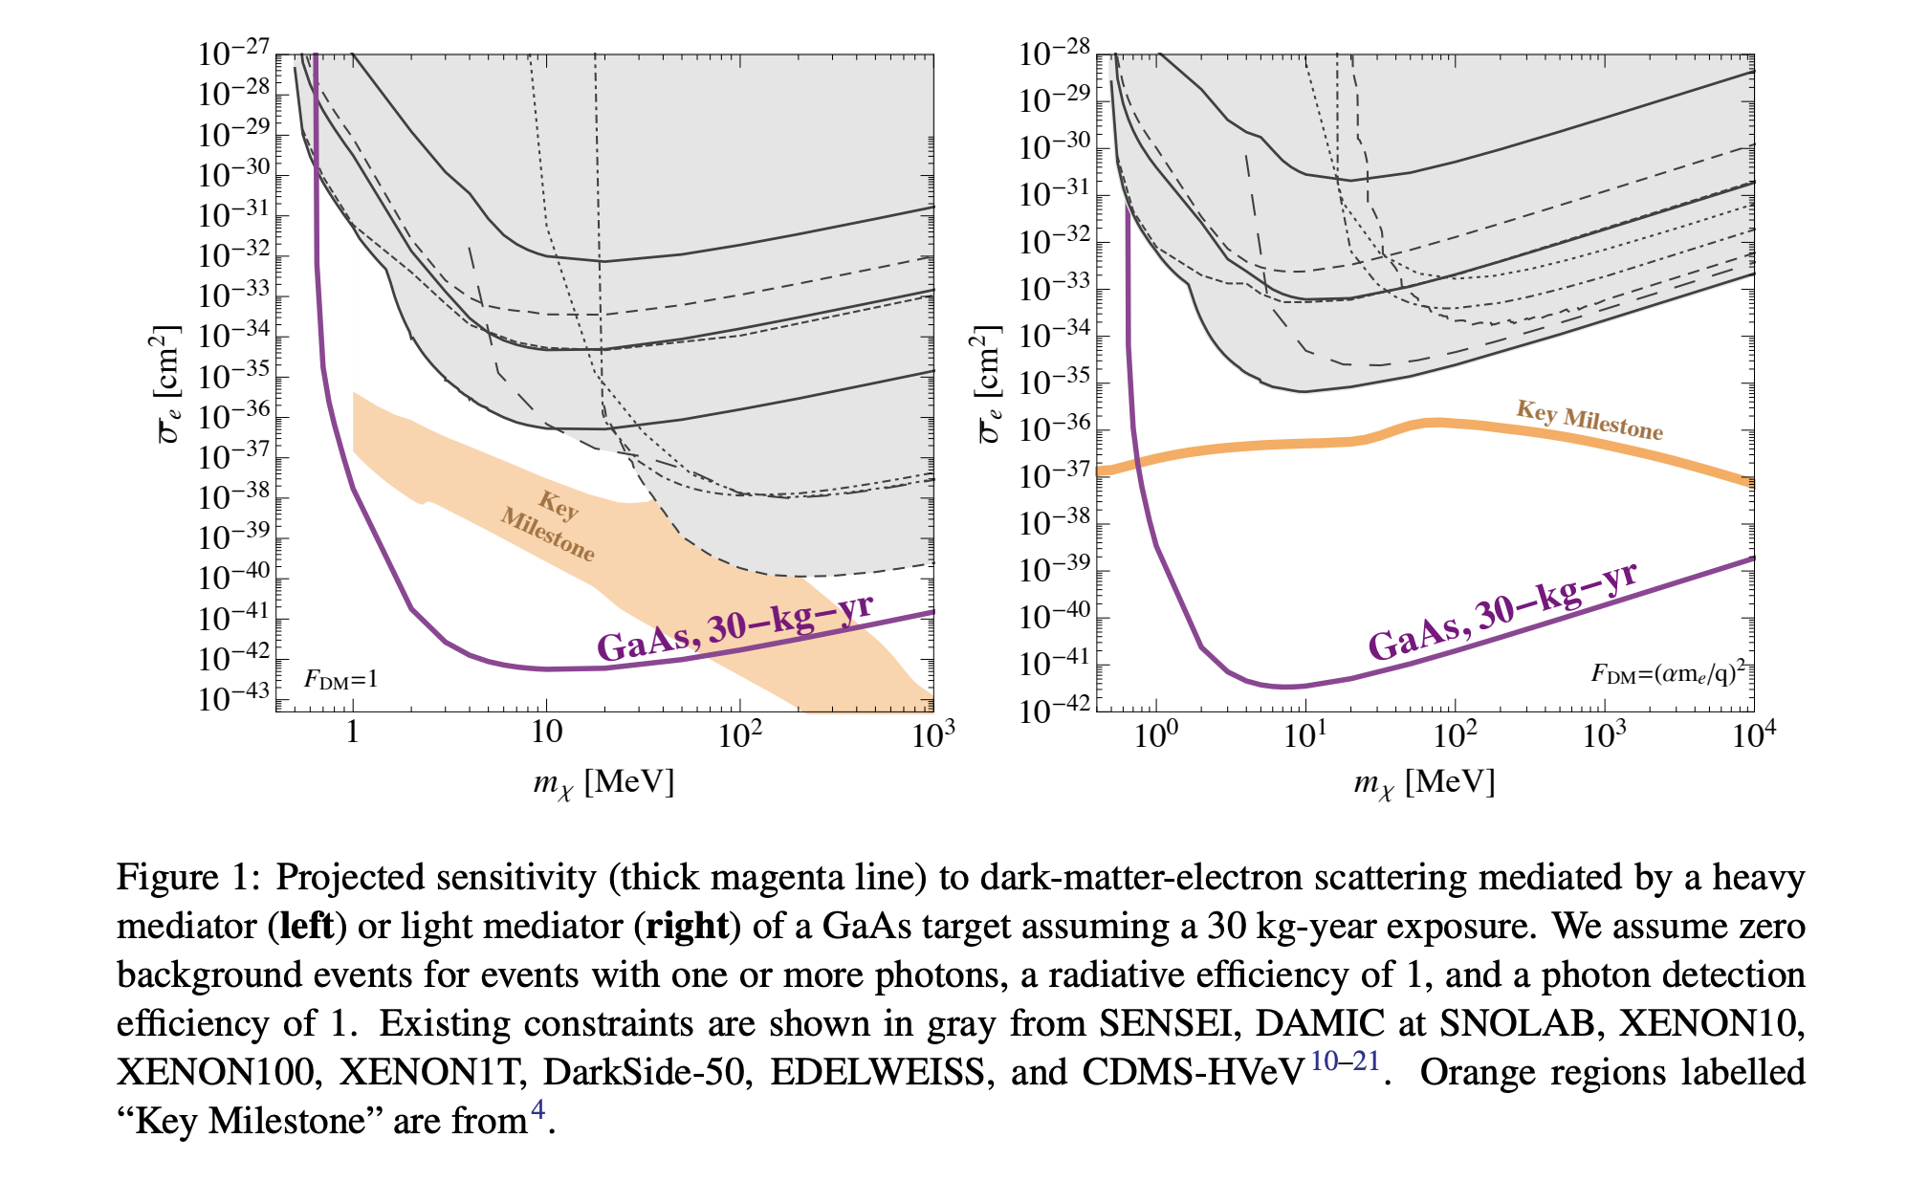
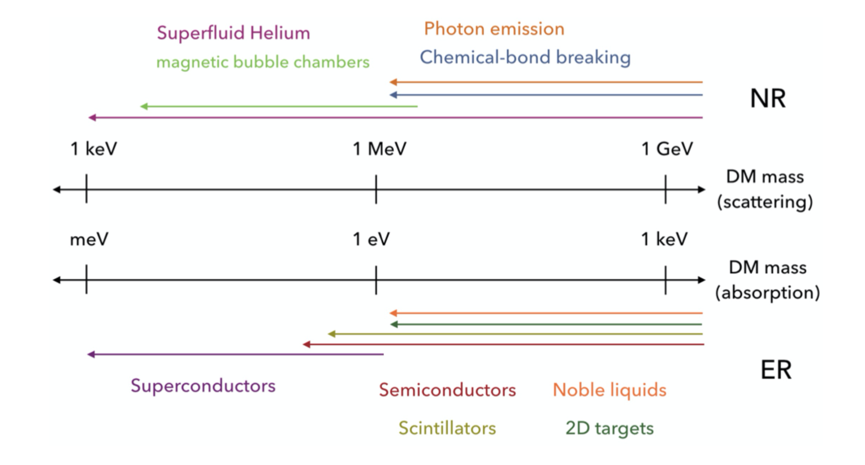
Direct Detection of sub-GeV Dark Matter
n-type GaAs doped with Silicon and Boron is a cryogenic scintillating target for the detection of electron recoils from interacting dark matter (DM) particles in the poorly explored MeV/c² mass range
JPL/LBNL collaboration: n-type GaAs as a cryogenic scintillating target

Slide 3
Detection Principle
DM
DM particle scatters off an electron in the valence band of a scintillating crystal target
Generation of an electron-hole pair
Emission of scintillation photon(s) from relaxation of the electron to the ground state
Detection by sensitive photodetector
n-type GaAs
SNSPD

Slide 4
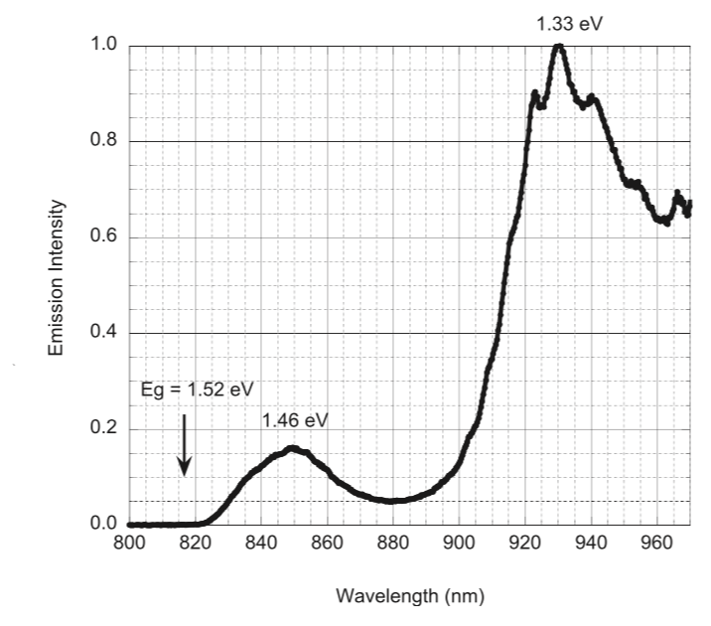
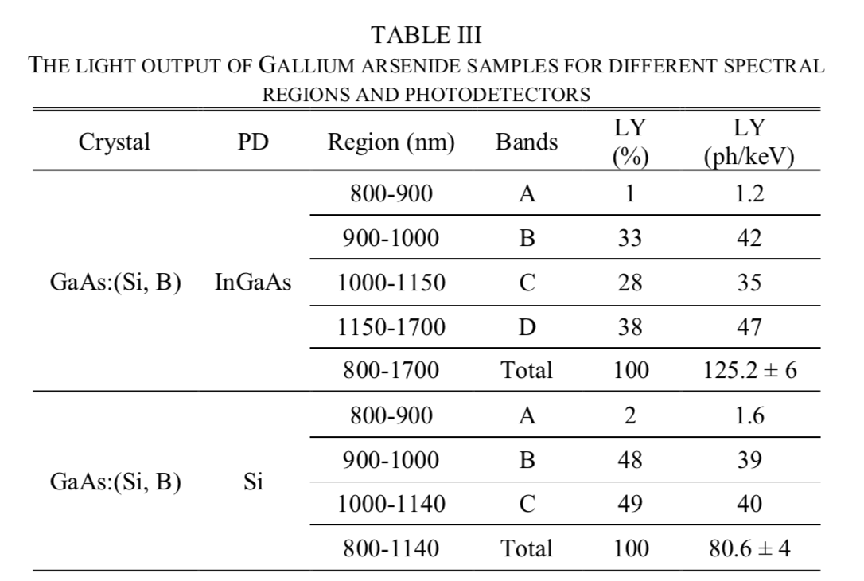
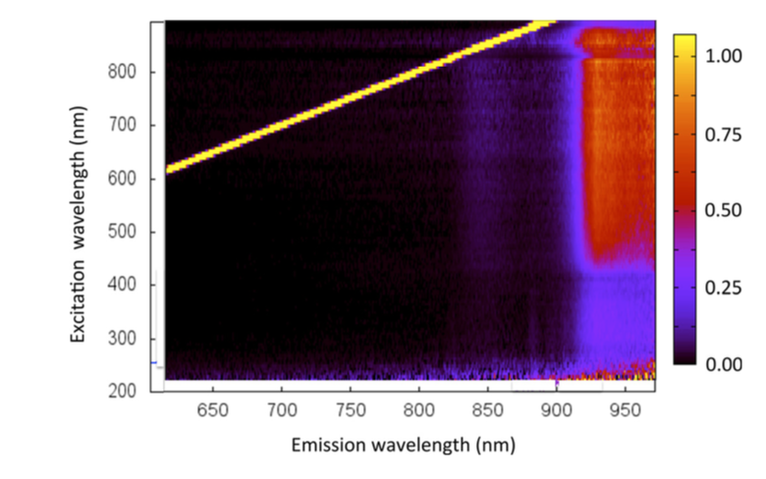
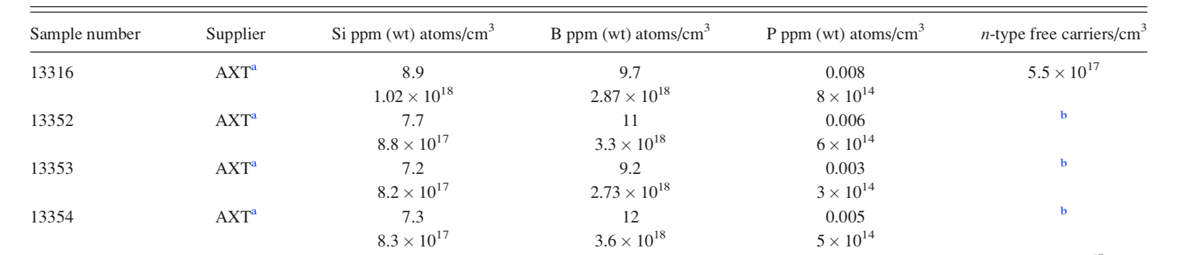
n-type GaAs Emissions:
measurements from LBNL
930 nm
2D map of emission as a function of excitation wavelength at 10K
X-ray excited emission spectrum at 10K
Notes:
Kilovoltage peak (kVp) is the peak potential applied to the x-ray tube, which accelerates electrons from the cathode to the anode

Slide 5
Status and Required R&D
Gallium Arsenide Targets
For a real DM experiment: targets on the order of a few kg
LBNL has sent us 1 x 1 x 0.5 mm test systems (~0.27 g)
R&D Goals: Optimize GaAs crystal size, surface roughness, and dopant density to maximize photon production and detection efficiency
  Optical simulations with Zemax – ongoing

Slide 6
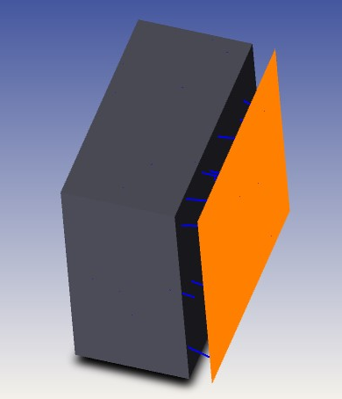
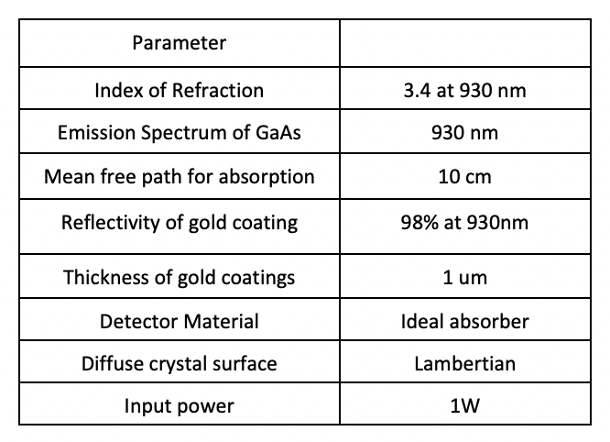
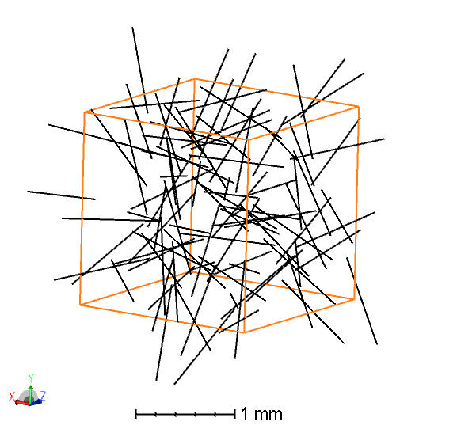
Proposed Design
Gold coatings
Gold coatings
Design: coat target with gold everywhere except for face adjacent to detector
Simulation: vary the target thickness
Simulated with and without AR coating on detector-adjacent face and diffusive and polished GaAs
What is the largest target thickness we can get away with for a given detector area?
Detector:
5 um distance
volume source
GaAs
Gold coatings
exploded view

Slide 7
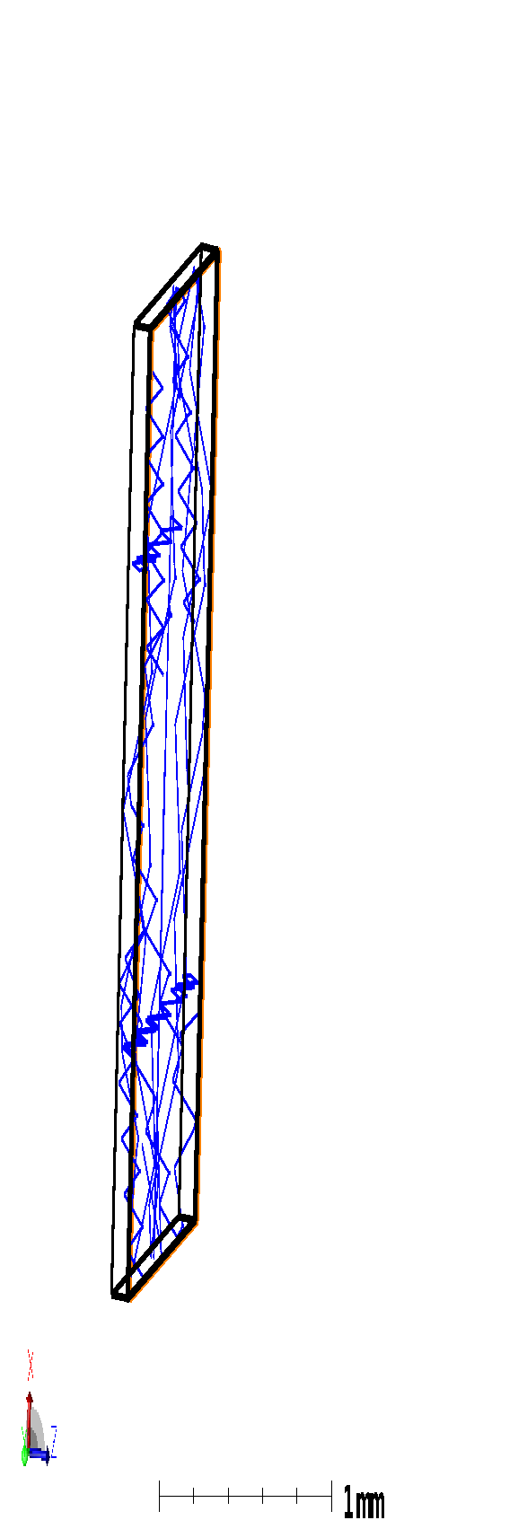
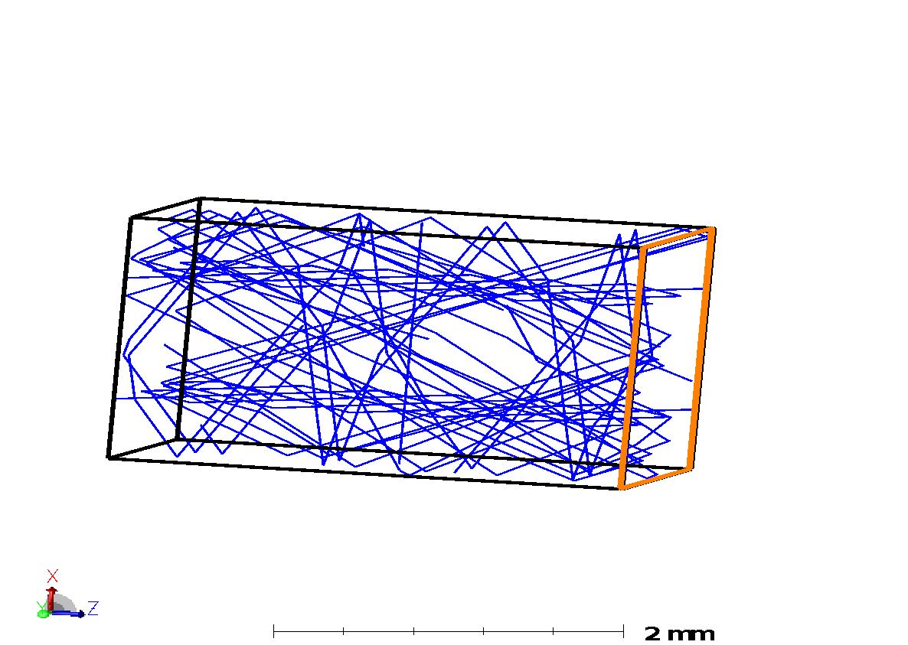
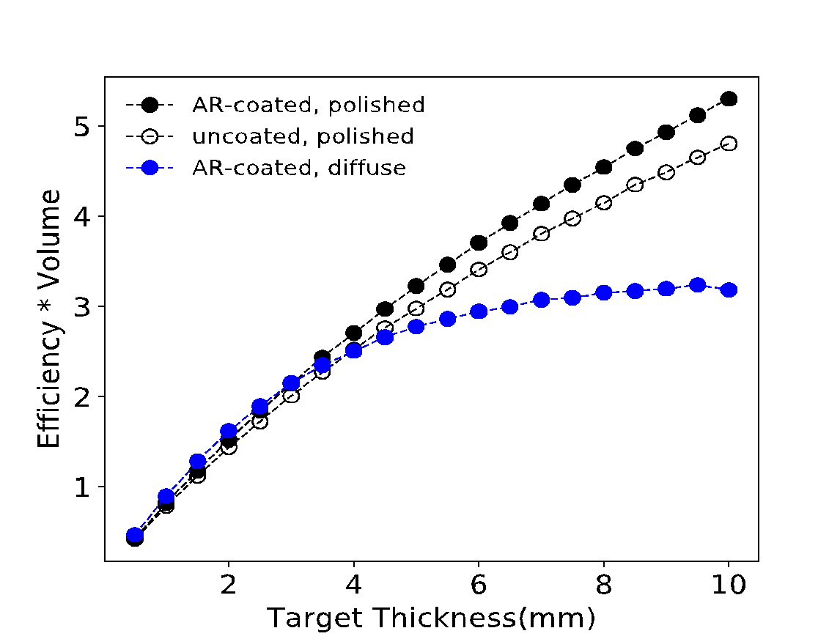
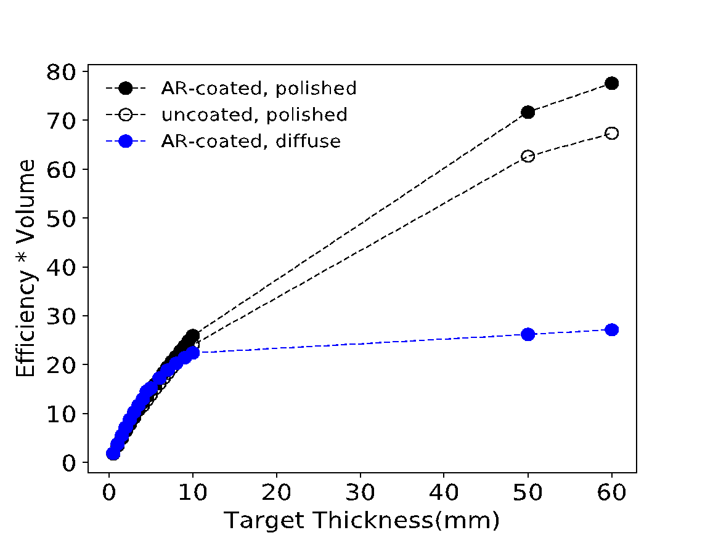
Target thickness
1mm x 1mm Detector
2mm x 2mm Detector
1 x 1 x 10
2 x 2 x 0.5
1 x 1 x 0.5
2 x 2 x 0.5

Slide 8
Upcoming Experiments
Cryogenic Measurements with test system: small GaAs targets (mm-scale) and 1 x 1 mm SNSPD
UV-excited lifetime measurements – soon
Precisely measure the luminosity
  UV-excitation – soon
  x-ray excitation – future

Slide 9
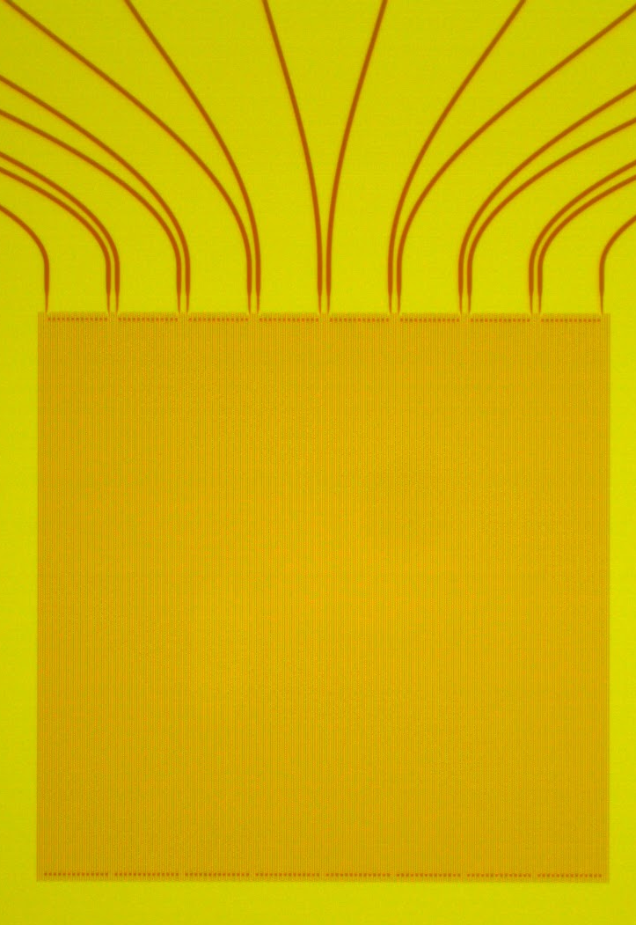
Status and Required R&D
Large Area SNSPDs
Goal: scale active area of SNSPDs from mm² to cm² and beyond to accommodate cm to m-scale targets
Microwire architectures
  Microstructures can be patterned by photolithography- less expensive and time consuming than electron or ion beam techniques used to fabricate traditional (nano-wire scale) devices
  More robust to manufacturing issues
  Significant reduction of the kinetic inductance by using micron-wide wires
Arrays allow for the possibility of vetoing coincidence events if those arise due to noise or cosmic ray events depositing energy in the substrate
1 mm

Slide 10
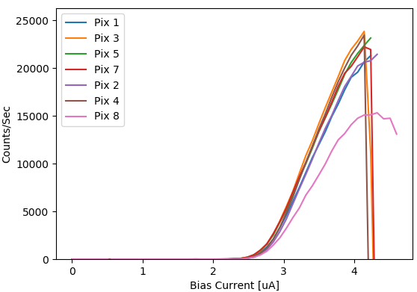
Large area WSi SNSPD arrays: preliminary results
1 x1 mm 8 pixel array with 0.5 um wires
1064 nm source
  Close to saturated internal efficiency - limited by latching with AC-coupling
  Promising preliminary results with DC-coupled readout showing higher switching currents.
0.9 Kelvin operation
0.5 - 3 um wire widths being studied
Achieved 7/8 pixels on first arrays characterized
Fabricated devices from other WSi stoichiometries
Tc range of 3.9 to 1.9 K being studied

